Slide 1



Slide 2
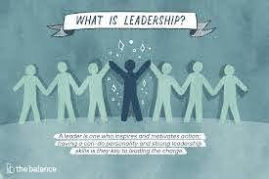
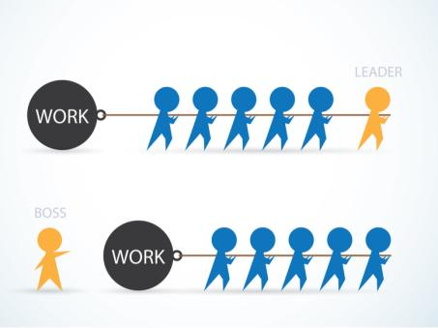
YOUNG ETHICAL LEADERS

Slide 3
Leadership - Definition
The term "Leadership" is polysemantic, and cannot be translated into Romanian by a single word that expresses its true meanings. Romanian dictionaries translate it by: leadership, command; chief, command; direction, leadership, conduct.
1. Leadership needs vision, encouragement, enthusiasm, love, energy, passion, obsession, consistency, use of symbols, being attentive to the priorities of others, creating heroes at all levels, tools, effective walks through organizations and a lot of other things .
2. We consider leadership as an activity that influences the behavior, beliefs and feelings of group members in a deliberate direction.
3. A leader has the ability to make people happy with what they do and helps people feel that their work helps them achieve the long-term goal of the organization. A leader challenges employees to go beyond the basic level of efficiency and try to reach their full potential; recognizes achievements, successes and rewards people. One of the most important traits of a leader is that he treats mistakes as learning experiences.

Slide 4
Leadership - Definiție
Leadership is not about leader.
Only a weak leader believes that he must be the center of the universe and that he must impose himself through an attitude of superiority.
A weak leader will always take responsibility for the team, but will reap the rewards of success.
A weak leader is selfish, fearful and imposes his point of view without arguments.
A weak leader will punch the table and not debate.
Therefore, a weak leader will never be loved, only feared by his people.
What does LEADERSHIP actually mean if we look at it as an acronym?
L oving (Lover)
E ncouraging
A ccessible
D auntless
E thical (Ethics)
R esponsible (S)
S ervant (servants)
H umble (Modest)
I nspirational (Inspires you)
P ersevering

Slide 5
CHARACTERISTICS OF A SUCCESSFUL LEADER
Being a successful leader is not as easy as it sounds. You have to meet a series of qualities, to have a certain mentality, to be oriented in a certain direction. Do you want to be one of the leaders worthy of praise?
Exercise : Write 5 qualities that a successful leader should have.
We present you the list of the 22 qualities that any successful leader must have:
1. Concentration power
Many believe that leaders make decisions of major importance. To be a successful leader you cannot turn minor things into major issues. If you do this, you will be distracted from the really critical things and you will be overtaken by your competitors.
2. Trust
A successful leader instills confidence in those around him. He has a clear vision, shows empathy and sets an example for everyone. As a leader, you must always be confident, motivate your people through the power of personal example, but at the same time show kindness and generosity.
3. Transparency
If you want the team to follow you all the time and trust you, you will have to be 100% authentic and transparent. We can all be wrong, so can you. However, if you show that you are passionate about what you do, if you are always with your people and you assure them through behavior, you will become a successful leader.
4. Integrity
Employees are a reflection of the values you instill as a leader. Be honest, but also be authentic and open in all interactions. The example comes from you!

Slide 6

CHARACTERISTICS OF A SUCCESSFUL LEADER
5. Inspiration
The secret lies in inspiration and perseverance. There are people who can inspire you, who can give you advice and who can become your mentors. They will feed your dreams and instill in you the desire to succeed.
In turn, offer advice and motivation, even to strangers. Just as others have helped you succeed, be open and help others.
6. Passion
You have to like what you do. Always invest passion in what you do. Always try to grow your business, to do better and bigger things. Don't lead by example just because you've heard it's okay - you have to be fully convinced of that.
7. Innovation
Innovation is essential! leaders
true are innovative. Indifferent
when it comes to ideas, technology
or organization, innovation is alone
the way you will be able to cope
challenges.

Slide 7
CHARACTERISTICS OF A SUCCESSFUL LEADER
8. Patience
Patience means courage. The path to success is always difficult, but true successful leaders understand when it is time to abandon the cause and when they must stay on the same course of action. Treat everything patiently and carefully analyze all the aspects you need to take into account for your business: foreign markets, competition, taxation, consumer demand and much more.
9. Firmness, courage, steadfastness
You will find yourself in difficult situations, whether it be costly mistakes, unexpected failures or unscrupulous enemies. The secret of success lies in accepting and anticipating these things in advance, so that nothing takes you by surprise. You don't want to react impulsively and make things worse. Train your mind, consider even the darkest scenarios and adjust your impulsive reactions.
10. Power of analysis
Understanding the numbers behind your business is the best thing you can do. Analyze any data. The secret lies in analyzing and knowing the meanings of the data that characterizes your business.
11. Originality
Every successful leader has something authentic. Learn from others, get inspired, read autobiographies of those you consider mentors. However, don't forget to be original. Don't lose your style, don't give up your own principles and always be 100% authentic.
12. Open mind
Reality will teach you that a successful leader must have an open mind, learn to be flexible and be willing to make changes when needed. You will have to make a commitment to invest in development all the time, while keeping your mind open.

Slide 8
CHARACTERISTICS OF A SUCCESSFUL LEADER
13. Decision-making power
When you have a decision to make, be firm. Make the decision, implement it and don't look back. This does not mean not to look back at all, because from past mistakes you can learn a lot. You have to have the power to make decisions, even if sometimes they will prove to be uninspired.
14. Be with people.
Focus on the relationship with your people and seek to help them with everything you can, instead of focusing only on the things they can do for you. You will become a nicer person. You will become a respected and appreciated leader. You will make considerable progress in your business.
15. Ability to delegate responsibilities and tasks. Your team members have diverse skills and talents. Learn to delegate responsibilities and authority. It's not always easy. Sometimes it will be even harder if you choose to perform a task on your own. However, by delegating responsibilities you will identify valuable people on your team and you will be able to focus more on development and innovation.
16. Positivity
You need to create a culture of optimism in your organization. There will always be ups and downs, but positivity will always be the element that will make things move forward. You also need courage and confidence.
17. Generosity
You have to give your best, but don't forget about others. Give them a chance to develop as individuals. Once you understand that collective growth is based on individual development sustained by your generosity, you will come even closer to becoming a successful leader.

Slide 9
CHARACTERISTICS OF A SUCCESSFUL LEADER
18. Perseverance
Many stop and are willing to give up everything from the first failure. One of the secrets of a successful leader is perseverance - that ability and willingness to continue beyond that point where many others have given up.
19. Intuition
You need intuition every day, including to make decisions and to distinguish between the important things that really matter and the rest of the situations to be solved. If you make a good decision based on intuition, you will look like a genius. If you misunderstand, it will be exactly the other way around and you will have to be able to assume that.
20. Communication
If those around you do not know your expectations, they will disappoint you. Express your expectations, but be willing to listen to the feedback and ideas of others. Only in this way will you be able to surround yourself only with talented people.
21. Responsibility
You don't always have to look for culprits if you know you're the one who made a mistake. Take responsibility, but don't stop there: find a solution to make things right and get them back in the right direction!
22. Be dedicated and tireless
It takes a real leader to be able to identify the strengths and weaknesses of each person in the team, to find the solution, to identify solutions to compensate for the shortcomings.

Slide 10
HOW TO BE A GOOD LEADER
People who indulge in subordinates and have no vision of their future professionally are not aware of the hardships they have to go through to become a leader.
The principles that people have followed in their path to success and which you should pay attention to if you aspire to become a good leader are the following:
1. Be a determined and well-prepared leader
In order to have a well-defined plan about what you are going to do, you need to know yourself very well, to be aware of the capacity you have and the knowledge you benefit from. It is important to know how to present your ideas as clearly and decisively as possible. The people around you will never follow you if you are undecided and have no idea where your plans are.
2. Be a dedicated leader who turns his business into a real passion
When you inspire those around you that you are a dedicated and determined person and that you have developed a passion for the field in which you work, you get to inspire them and motivate them to follow you. Once you have gained their trust, you will have to work every day to prove to them that they have made the right decision.
3. Demonstrate that you have the experience to be a leader
Regardless of the field in which you develop a business, skills are very important. They develop as a result of experience. You need to be an example to your employees and set some principles that those around you must follow.

Slide 11
HOW TO BE A GOOD LEADER
4. Constantly strengthen your connections with people in the business environment
No entrepreneur can build a business on his own. Your connections must grow with your business, if you are active in the local community and in connection with the business environment.
5. Calculate your decisions well
It is important to know when to act, a good decision made at the right time will have an important influence on the development of your business. Smart leaders think well about their decisions and alternatives.
6. Inspire as much confidence as possible
People do not like to follow a leader who is unpredictable and prone to sudden changes in vision. A true leader wants to create a close connection with the people around him, inspiring trust.
7. Develop open-mindedness and encourage innovation
In business you must always be creative and work constantly to improve and develop your business. Do not wait for the moment when the competition will force you to improve your services in order to rise to the level of the market that they have created through a continuous innovation.
8. Be responsible! Assume the consequences of every decision you make
Entrepreneurs who want to become leaders should not use excuses when making the wrong decision. The moment you want to innovate as much as possible, there is a risk of failing. It is important to analyze the factors that led to that result and when you make the next decision, the experience gained from the mistakes you made to speak.

Slide 12
MOTIVATIONAL TECHNIQUES - HOW TO FIND A JOB AND CAREER
There are some general and applicable rules for looking for a job, and for all this you will need the following:
Perseverance - new opportunities appear every day. For this reason we must constantly pay attention to everything that occurs
Constancy in applying - even if you are called for an interview or you are in a final stage you do not have a total guarantee that you will get that job
Optimism - even if you apply for several opportunities and find that you are not required for an interview, you must find the motivation to persevere. Certainly, even if it takes longer, you will be able to get what you want
Seriousness - if you applied it is normal to honor the invitations to interviews
Sincerity - once you have been accepted and made a decision you will need to be honest and inform the companies that will continue to ask you about it.

Slide 13
MOTIVATIONAL TECHNIQUES - HOW TO FIND A JOB AND CAREER
I offer you some tips , which, if you use them, the probability of finding your desired job will increase considerably.
Tip 1 - Apply only to jobs for which you consider yourself suitable
Stop sending dozens or hundreds of resumes a day. Someone might call you one day. But this is a quantitative approach that in terms of quality does not offer you great chances. Apply only to a few jobs a day (3-4).
Tip 2 - Read the job requirements and assignments carefully
This is when you find out if that job is right for you. Read the requirements carefully and consider whether you meet the minimum requirements. Ask yourself a few questions: Do I want this job? Am I suitable for him? Am I qualified for him?
Tip 3 - Find company information
If the name of the employer is also published, do a short search and find out more about the company: field of activity, points of work, turnover, values ​​of the company, etc. Find out how many things are possible.

Slide 14
MOTIVATIONAL TECHNIQUES - HOW TO FIND A JOB AND CAREER
Career selection criteria
The job market has changed, the job offer has decreased significantly, and the number of viable options you can consider when choosing a career has decreased. In this situation it is advisable to find the ideal compromise between personal desires and the pressure to get hired quickly based on a clear set of criteria.
When it comes to choosing the career that suits you, the most important thing is to choose the ones that matter the most from the multitude of criteria you can use. Here are three criteria that are universally relevant .
1) What it means to work in reality
Most young people do not really know what a particular job or field entails, what their real activities are and their share in the work schedule, but only what is seen on the surface. Talk to people inside, to people who are already in the field and can give you real and complete information.

Slide 15

MOTIVATIONAL TECHNIQUES - HOW TO FIND A JOB AND CAREER
2) The opportunity to use your
strengths
Your strengths are your skills
natural. It is totally ineffective to throw yourself into a field for which you do not have natural abilities and to waste the abilities that you have naturally, but do not know or ignore.
3) Learning experience
The opportunity to grow is at the beginning of your career one of the most important things you need to have in mind. A poorly paid job is unpleasant, but even more unpleasant is a job where you stay at the same salary you entered with, because you do not learn anything new, you are not interested and provoked by what you do.

Slide 16

MOTIVATIONAL TECHNIQUES - HOW TO FIND A JOB AND CAREER
Job search techniques
Many people looking for a job feel disoriented - they don't know where to go and how to behave. If you do not know how to look for a suitable job, this can be learned. Anyone who knows how to do something knows that he has learned from others or discovered through his own means and abilities.
The first thing you need to know when looking for a place to work is to know what you are looking for. What do I want to be? What position do I want to work in?
It is good to think about the following:
- what training do I have or what training can I obtain after a training course ?;
- what professional skills are required for a certain job?

Slide 17

MOTIVATIONAL TECHNIQUES - HOW TO FIND A JOB AND CAREER
The second step is to know which institutions,
firms, companies or organizations can offer such jobs.
ƒ talk to people you know or work in the field;
ƒ read specialized magazines;
ƒ read the presentation leaflets of companies, institutions.
The third step is more difficult to accomplish, but not at all impossible: you have to discover the company or institution that has a job vacancy as the one you want.
- you can contact the company / institution by direct visit, letter or phone;
- you must learn to write a letter of intent, to design a curriculum vitae,
- know how to appear for a job interview,
- know how to write a thank you letter.

Slide 18
MOTIVATIONAL TECHNIQUES - HOW TO FIND A JOB AND CAREER
How and where you can get it
information about possible jobs (vacancies)?
1. Advertisements are the primary source of information, but you don't have to rely solely on that source of information.
2. Placement agencies are very useful if you have a good professional training in a current field.
3. Direct contact of institutions or companies. They are very important: presentation, manner of communication, ability to please you, self-confidence, spontaneity. If you manage to talk on the phone with the person in charge of employment, be short, polite and to the point. Another way to contact that person is by letter or directly.
4. Employment and training agencies - provide all the services and information you need to find a job.

Slide 19
MOTIVATIONAL TECHNIQUES - HOW TO FIND A JOB AND CAREER
5. The Internet - a modern method of looking for a job. Especially the younger generations are trying to find their dream job through the Internet, and as the number of those looking for a job online increases, so does the number of offers on the Web. However, it is very difficult to track the posts and services published on the Internet due to their number and variety.
6. Networking or "network of personal contacts" indicates the establishment of personal contacts and is a very useful tool. Family members, relatives, friends, colleagues or their relationships can be very helpful.
7. Identifying employers - identify and research potential employers that might match your interests and abilities. Employers and company directors can tell you exactly which companies you would be interested in. Ask the network contacts you've already formed if you know people who work for the company you're interested in and who you can call for information. You can send letters to those companies or find out if they have vacancies.
8. Identifying trends - try to identify what kind of career, profession could appear in the coming weeks, months or years by recognizing the factors that create and stop the existence of jobs: mergers, staff reductions, new social issues, politics, legislation, environmental challenges, etc. Stay informed, from newspapers, magazines, news about the current situation regarding the new trends in the field of employment and new types of professions.

Slide 20

HOW TO BEHAVE WITH THE EMPLOYER
How to prepare for the job interview
1. Carefully review the ad - it is important that the person is able to thoroughly prepare answers to the employer's potential questions.
2. Create a list of the questions you expect to receive from the employer and another with the most important achievements and qualities, which are not necessarily found in the CV. Start with the list of strengths. Employers may also ask you to talk about your weaknesses or failures and the lessons you have learned from such experiences, and you need to give honest answers that do not put you in a negative light.
3. Find out in detail about the company's activity and job requirements.
4. Do a short rehearsal before the interview,
so that you get rid of the last emotions.
Try to adopt a natural attitude and
friendly, which will help you gain sympathy
interviewer and relax and let
turn the whole discussion into a conversation.

Slide 21
HOW TO BEHAVE WITH THE EMPLOYER
How to prepare for the job interview
5. Prepare the right clothes. The interview outfit is the classic office outfit, slightly sober, in neutral colors. The most indicated colors are black, blue and gray, while orange seems to be the least recommended for the interview outfit.
6. Take a diary and a writing tool with you - it will be useful during the discussion with the employer.
7. Don't forget to write down the contact details of the place where the interview will take place and a telephone number that you can call in case you get lost or you happen to be late for the meeting, for objective reasons.
8. Make sure you have printed a CV and a letter of intent, as well as some recommendations from former employers / collaborators.
9. Come on time - come 10 minutes before the interview, make sure you don't miss the scheduled time.
10. Be respectful, keep eye contact, smile;
11. Listen carefully - you don't have to talk to the interviewer without letting him finish his questions and ideas;
12. Answer questions - there are many candidates who answer completely different questions; but also ask questions - both about the role you will play if you are employed, and about the long-term plans of the company;

Slide 22
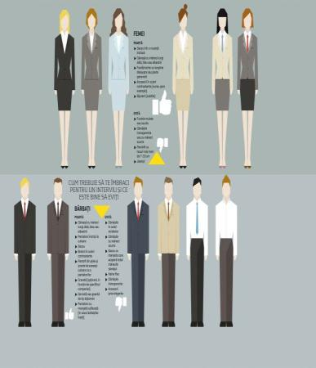

HOW TO BEHAVE WITH THE EMPLOYER
How to prepare for the job interview
13. Stay away from generalities and give examples - go from “I am a good member of the team” to “A year ago, when I was part of team X, I worked on project Y where I played a key role. .. ";
- The day before the interview - prepare your outfit, accessories, shoes, bag, check online or go to the address where the interview will take place, you can review the answers to the most frequently asked questions of the interviewers, go to bed in decent time to be sure that in the morning of the interview you will not be tired;
- In the morning of the interview - prepare a healthy breakfast, you have to arrive 10-15 minutes earlier, smile, adopt a friendly attitude both when interacting with the reception staff, hang up or shut up before the interview.

Slide 23
HOW TO BEHAVE WITH THE EMPLOYER
How to prepare for the job interview
✘ Your phone rings - turn it off or set it to silent;
✘ Nonverbal language - the way you hold hands or the way you look at the interviewer says a lot about you; make sure you don't have an arrogant attitude; this can be corrected with the help of a sample interview with a friend;
✘ Talk badly about former colleagues or your former employer - no matter how you got along with your former colleagues or how you left things, don't talk bad about them and don't lie about telling past dramas. Be honest, he says you didn't integrate and moved on;
✘ Improper clothing - HR specialists rejected a candidate from the moment they saw him because of the way he was dressed;
✘ Forget about asking questions about the company - you need to ask some general questions that show the person in front of you that you want to work there;
✘ You are too focused on the financial aspect - the salary matters, but it is not the sure thing for which you choose to work in a company. The relationship with colleagues, the possibilities for professional development matter.
✘ Appear at the interview without being prepared in advance. This means knowing the most important information about the company and the industry in which it operates and knowing the information in your resume.

Slide 24
SOCIAL RESPONSIBILITIES - How to be a good professional
Any professional should make sure that as time goes on, he becomes more skilled in his profession or career. Regardless of the field you work in, you should make sure that you invest time in the future of your career. This way, you will improve your performance and you will have better results, and the changes will not take you by surprise.
Here are some ways you can become better at your business:
1. Make it a habit to read books useful for your profession - start by building a reading list of books essential in your field of activity, those that are recommended by specialists. Establish a reading schedule so that you can estimate how much you can spend weekly or monthly. The list should be updated with new relevant titles.
2. Take on more responsibilities - you show that you can do more for those around you - including those with decision-making power over your career, such as your superiors. Be careful not to overload your schedule and respect a healthy balance between personal and professional life.
3. Participate in courses, conferences, workshops - if you have the opportunity, participate in all courses, conferences and workshops that help you become a better connoisseur of the field in which you work and that keeps you up to date with the latest changes.
4. Develop your leadership skills - no matter how good your ideas are, you can't work on your own to put them into practice, especially if they are complex.

Slide 25
SOCIAL RESPONSIBILITIES - How to be a good professional
5. Pay more attention to detail - in addition to information and knowledge, details make a difference and in practice, often the level of attention to detail is impressive. You should know and differentiate between situations where efficiency or short-term compliance becomes a priority.
6. Study individually - discover for yourself, search and read, possibly tell your colleagues if you found something new. Don't limit yourself to classes. These are the minimum information provided. True competence derives from individual study. Remember that you are solely responsible for your success or failure in life.
7. Ask yourself questions, think, be critical - you need to pass new information through the filter of your critical thinking. I don't remember. Extract the information, ask yourself questions, find out why some people thought one way and others another, form your own universe of knowledge. It will help you in the future to have your own ideas, your own theories, therefore you will keep your professional independence and you will not be intimidated by anyone, no matter what functions it has. Learn to be independent, vertical, to hold on to your own opinions, to be able to support them with arguments.
8. Never think you know them all . - no matter what level you are at, you need to know that you still have a lot to learn. Only he who knows too little considers himself very well prepared. We should all develop our full potential.
9. Don't run after money - when you do your job, do it as if you were doing it for yourself, as if you didn't need anything. If you are happy with how it turned out, be sure that others will appreciate you as well. Notoriety and serious money come later, do not force things, do not be greedy.

Slide 26
SOCIAL RESPONSIBILITIES - How to be a good professional
10. Speak only when you have something to say - when you communicate something, make sure you have something to say. Don't come up with trivial things just to get important and accumulate some credit. It presents with passion, emphasizes the novelty, captivates the audience.
11. Don't accept being told nonsense and take action when you don't agree - think critically and don't be impressed by titles or positions. Take a stand when you hear aberrations, make logical, rational, scientific arguments. Support your point of view and don't let yourself be trampled on. When you are in control of the situation, when you know, it will not be difficult for you to develop the dilettantes.
12. Don't go where you don't know - if you face a situation that you can't handle perfectly, it's better to transfer the case or turn to a professional in that field.
13. Accept when you are wrong or when you do not know - do not persist in error. Yield to arguments, admit that you were wrong, learn from the experience of others. No matter what level you are at, there can always be someone who knows something you don't know. Listen to him and learn.
14. Associate with quality people - scientists are constantly at odds with the desire to support their ideas and find out, as much as possible, the truth. Don't be afraid to get into controversy. Support your ideas, believe in them, argue them. Set realistic goals and achieve them. Yield when the arguments are clearly against you. Do not tolerate stupidity and do not enter into controversies and discussions with fools or malicious people.

Slide 27
Ethical communication - Social media
Social media are computer-mediated interactive technologies that facilitate the creation or exchange of information, ideas, career interests, and other forms of expression through virtual communities and networks.
Social networks facilitate the development of online social networks by connecting a user's profile with that of other people or groups. Users typically access social media services through web applications on desktops and laptops or download services that provide social media functionality on their mobile devices (e.g., smartphones and tablets). As users engage with these electronic services, they create highly interactive platforms through which individuals, communities, and organizations can share, co-create, discuss, participate in, and modify user-generated content or self-cleaning content posted online. In addition, social networks are used to document memories, to find out and explore things, to advertise and make friends, and to grow ideas from creating blogs, podcasts, videos, and websites. hate games.
Social media differs from traditional media (e.g., magazines, newspapers, TV, and radio) in many ways, including quality, coverage, frequency, usability, immediacy, and permanence.

Slide 28

Ethical communication - Social media
The definitions of social media can be numerous, depending on the facilities offered by each network:
✓ Social interaction which, through web technologies, turns into an interactive dialogue between users. Between them there is not only a sharing of impressions, opinions, but also audio, video or text content.
✓ Marketing tool, addressed to the target audience, used in order to increase the visibility of a company.
✓ Way of communication and formation of groups that share common interests. The interaction occurs in real time, between people who can be in any part of the Earth, in fact which increases the intrinsic value of such a group.
Each user can have their own definition, adapted to one of the main functions of
social media platforms :
✓ publication
✓ sharing
✓ discussions
✓ marketing
✓ realization of events
✓ groups
✓ games

Slide 29
Ethical communication - Social media
So we can say that there are several types of social media:
✓ Social networks - offers the possibility of interconnection between people who share similar interests, concerns. Among the most popular are Facebook and LinkedIn.
✓ Blogs and forums - communication between users is achieved by posting messages dedicated to the main topic of the discussion forum or the main message expressed in the blog.
✓ Microblogs - is a type of blog through which users can publish short updates called microposts. The most popular in this category is Twitter.
✓ Media content sharing - users can download, share, watch or listen to media content (songs, movies, photos), as well as the ability to appreciate or comment on the material. Among the most popular are YouTube and Flickr.
✓ Bookmarking sites - offers the possibility to search, organize and save your favorite links. The best known are: Delicious and StumbleUpon.
✓ News of social interest - these sites promote the most read, impact news of the moment, sorted according to the preferences of readers and the number of shares. The best known are: Reddit and Digg.
It should be noted that these types of social media are not independent, there are interconnections between them.

Slide 30
Ethical communication - Social media
1. Facebook
Since 2006, the network has become accessible to any user over the age of 13 and with a valid email address.
What is the target audience?
✓ companies - with over 1 billion active users and approximately 700 billion seconds spent monthly on this platform, Facebook has encouraged its use as a real marketing tool. So, in the top of trainability are the companies that can thus attract new customers. Promotion is fast and does not involve high costs. Facebook has become a must-have, a customer-oriented business card for any product and service provider.
✓ State Governments and public institutions have doubled their presence in the virtual space by using official sites, by creating Facebook accounts. With a less informal presence, the activity of these state representatives has become much more visible in society, and the perception of the general public has changed in terms of the degree of transparency of these institutions.
✓ society as a whole - Facebook users have diversified. All social media are involved, covering all ages and occupations around the world. The platform is addressed to all those who want to communicate remotely with relatives, friends, by exchanging information, almost instantly. The Facebook platform currently hosts more than half a million applications, and approximately 950 million users access the platform from mobile devices. The high degree of accessibility will drive developers to create new and new applications that maintain user loyalty.

Slide 31
Ethical communication - Social media
offers multiple ways of online communication: messages, blogs, audio and video materials
communication with people from any part of the Earth social implications
network of friends: family, reconnecting with old acquaintances, or creating new relationships or attracting supporters (fans)
association of people who share the same concerns, opinions
participating in important events or achievements in the life of friends
expressing opinions and receiving feedback
initiation of joint actions (meetings, demonstrations, marches, etc.)
access to personal data and activity on Facebook may be restricted if the user wants confidentiality in marketing activities
running campaigns and advertising
feedback from consumers
formation of visibility brand image
official accounts of state or private institutions through which they communicate with their target audience
✓ addiction induces the loss of contact with real social life and, implicitly, the breakdown of connections that do not involve the use of virtual space
✓ decrease in school performance among young people
✓ contact with malicious people, which can cause conflict, which can jeopardize the emotional balance of certain people (usually among young people)
✓ being a public space, there is a danger of using the activity on Facebook against the user (a fact often encountered especially in public cases)
✓ creation of groups that promote discriminatory or extremist messages, in order to influence and co-opt new members
✓ being such a powerful platform, Facebook induces a monopoly
✓ false identity through the possibility of posting unrealistic data that mislead or identity theft
✓ personal data can be used for the purpose of tracking the user, without his will
✓ the more personal data displayed, the greater the danger that they will be used by crackers in order to break bank accounts, email or PayPal
✓ hacker attacks in order to spread malware (malicious software).

Slide 32
Ethical communication - Social media
2. Twitter
Twitter was created in 2006. The term twitter means the chirping of birds and defines the basic idea of the platform: short messages, with a maximum length of 140 characters. The goal was to communicate in short messages with a group of people.
Similar to the Facebook network, Twitter initially started as a project for a small group of people, in the form of an internal service. It is a hybrid, combining both the characteristics of a social network and those of a micro-blogging site, allowing its users to transmit information, comment on various events and bring to the attention of other users a certain video or audio content.
What is the target audience?
✓ companies - can develop the business by promoting ads for sales, promotions, news or services. Then, the network can be used to stay connected with customers and attract potential customers.
✓ the state - public institutions create and maintain links both with each other and with their target audience
✓ society - millions of people use Twitter to share opinions, exchange ideas and keep up to date with news in their area of interest.
Compared to Facebook, Twitter has not yet managed to impose itself on social media in Romania. Increasing the quality of the content of the disseminated information, attracting as many personalities as possible in this space, which, in turn, would stimulate the increase of the number of followers, would probably succeed in attracting the interest towards Twitter.

Slide 33
Ethical communication - Social media
Benefits
✓ It is free
✓ high communication speed
✓ information is shared with friends, family and interest groups
✓ connection with the marketing market
✓ monitoring the competition activity and subsequent adaptation of the marketing strategy
✓ contact with customers and potential customers
✓ Posts can be integrated on other platforms, such as Facebook or MySpace, so that they appear in real time on those accounts
✓ companies or institutions can be in permanent contact with the news that can influence their activity
✓ there is a permanent monitoring of the activity on Twitter in order to eliminate illegal activities that could be disseminated through the network.
Drawbacks
✓ false identity
✓ spam: one of the problems of Twitter is the large number of unsolicited messages faced by the user who is thus forced to make enough effort to filter them
✓ contact with people who use the user's personal information for illicit purposes
✓ a large number of followers can become, over time, one of the causes of losing the user's focus on the purpose of his existence on Twitter
✓ the number of followers does not represent the real number of people who really have an involvement in the life and activity of the user;
✓ the relationship with those who follow the user's activity (Followers), often works the principle of reciprocity, without any other personal significance
✓ limited message size
✓ High level of accessibility may affect the user who will neglect real life concerns in favor of following the activity on Twitter

Slide 34
Ethical communication - Social media
3. Google Plus
Matching likes and search results triggered the reaction of Google, the owner of one of the most popular search engines. This is how Google Plus appeared in 2011. Google Plus is not a social network, the project is much more complex, going beyond what involves social networking options, efforts are directed not at the number of appreciations (so as in the case of Facebook), but towards the development of tools that are offered to users. These tools are the ones that will trigger a quality social interaction.
In conclusion, we can say that Google Plus is the social level where all the tools offered by Google are embedded and intertwined.
What is the target audience?
✓ society - various options, with a friendly interface, which meet the requirements of users
✓companies - direct connection with consumers: information on offers, job description, the possibility for a company to be found by potential customers, building a customer and partner base, increasing visibility through advertising
✓ IT market - encouraging developers to build new and new options for Google
Google Plus is integrated with other platforms, such as Google Calendar, Gmail, Google Maps, and users can connect their websites to Google+ pages.

Slide 35
Ethical communication - Social media
Pro Google Plus – Advantages
✓ Accessibility - presence on Google+ allows access to all services offered by
Google: maps, news, YouTube, search, gmail etc, - friendly interface; it has no character limit
✓ society - interest groups (circles), text, audio or video information create strong links that can become sources of business development or events.
✓ Google Plus is growing in popularity both due to the constant concern for the quality of options, and due to the diversity of these options. In addition, Google has a well-known brand image
Against Google Plus – Disadvantages
✓ the non-existence of applications, which remain the strong point of Facebook
✓ For new users, navigating the menus can be difficult at first, compared to Facebook popularity
- for now, the increased popularity of Facebook causes a user to unsubscribe from Google+, because the chances of finding people known is much higher in the case of Facebook
- not all companies, institutions have a Google+ account, which reduces the possibility for the target audience to choose to create accounts to communicate with them
4. Modern applications dedicated to mobile platforms, such as Instagram or WhatsApp. (photo and video content sharing).

Slide 36
Ethical communication - Social media
5. LinkedIn - 2003 is the year of the launch of the largest professional network in the world.
What is the target audience?
LinkedIn is a network that addresses professional profiles, so it's about potential employees and potential employers. It is also the place where the business environment can develop by attracting customers, partners or investors.
After creating a profile, the user:
✓ develops a network of contacts (connections) that can be sorted by categories: direct connections and connections of members in the contact list
✓ uses the recommendations in order to choose a job in the same way as an employer can look for potential candidates
✓ can update his profile, post pictures
✓ can track a specific company and use bookmarks to highlight favorite jobs
✓ receives feedback about users who have visited the profile page
✓ can interact with people in the network of contacts
✓ can join groups (public or private) with a certain specific interest
Network applications allow:
✓ profile display of personal preferences
✓ displaying posts from your own blogs
✓ posting opinions, comments
✓ use on mobile platforms
✓ display statistics related to a specific company,
✓ the service through which the user's data are promoted, for a fee, in the whole network.

Slide 37
Ethical communication - Social media
Pro LinkedIn – Advantages
✓ communication in the professional environment
✓ developing a personal profile that highlights professional skills
✓ increasing the visibility of companies and institutions
✓ exchange of ideas, opinions
✓ selecting the right employee
✓ employment opportunities
✓ global perspective on the professional environment
Against LinkedIn – Disadvantages
✓ cumbersome time-consuming interface to understand all the options offered by the network
✓ the risk of losing information by not constantly accessing the account
Because it has had a significant increase in popularity, LinkedIn will take advantage of the upward trend to impose itself on the labor market. In support of this goal, the development of applications and the attraction of new members by trying to cover a growing area, both geographically and professionally, are considered.

Slide 38
Ethical communication - Social media
6. Other social media tools: YouTube, Pinterest, blogs
In 2005, a website was built to cover the need for video content distribution. It was called YouTube. An important step was the possibility of visualization
YouTube materials directly from the Google Chrome browser and the GooglePlus platform.
YouTube offered something special, namely: social interaction. Users can upload, appreciate and discuss a specific material which, in turn, can be integrated into their own website, blog or emailed. Also, a video can be shared on own accounts of Facebook, Twitter, GooglePlus, Blogger, LinkedIn, Pinterest etc. Like the search engine, Google and YouTube offer search suggestions. Registered users can form their own channels and form a list of favorite channels so that they are informed in their field of interest.
Benefits
✓ It is accessible and free
✓ is a means of promotion
✓ varied content: music, movies, commercials, etc
✓ social interaction, the possibility of feedback
Disadvantages
✓ the risk of viewing inappropriate content / language and copyright infringement
✓ limitations regarding the file (size, duration)

Slide 39
Ethical communication - Social media
Pinterest is a website launched in 2010, through which users can create and view collections of images and videos. Users can create their account either directly or through social platforms such as Facebook or Twitter. Preferred materials can be selected and then grouped into categories, called boards.
Benefits
✓ It is free and has a friendly interface
✓ there is interaction between website members who have the opportunity to appreciate and publish comments
✓ the possibility for the user to install the Pin It button in the browser, so that, whenever he encounters a special material, it can be selected through this option
✓ addresses bloggers, artists, companies that can promote themselves in this way
Disadvantages
✓ the interaction is largely based on visual impact
✓ privacy issues (connection between Pinterest and Facebook or Twitter accounts)
✓ the risk of copyright infringement.
Blogs have developed by choosing the online environment over the press, so many journalists, analysts, personalities have created blogs through which they have created a faster, more humane bridge to the target audience. Acute problems of society are addressed, which is why the blog is increasingly used as a tool for communication with the citizen. However, a blog can qualitatively outperform the activity on a social network and can highlight the author, provided that what is expressed is of good quality and interest.

Slide 40

THANK YOU FOR WATCHING!

Slide 41
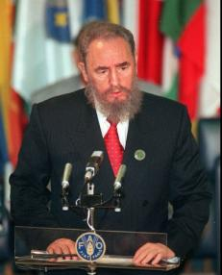
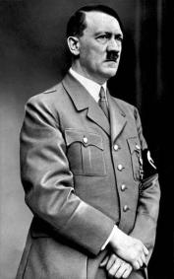
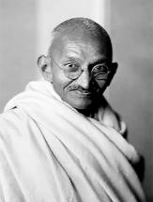
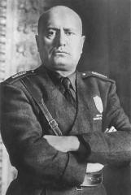

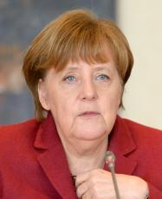
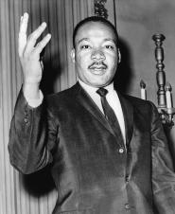

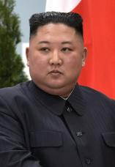
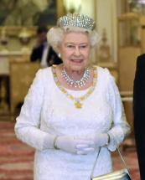
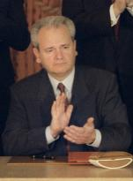

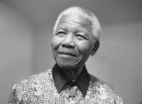
LEADER

Slide 42
The word leader comes from the Old English word 'lædan' meaning 'to go before as a guide'. It was first used in English in the 14th century to describe a person in charge, and then various other uses came about later.
LEADER
=
GUIDE

Slide 43
...a more poetic definition
*in norse mythology, einherjar (sing. Einheri) are the spirits of the fallen in battle, welcomed to Valhalla.
LEADER = EINHERI*
Einheri = [he who] fights alone amidst the army

Slide 44
LEADER/LEADERSHIP
Styles
Character
Contest
Situation
Luck
One thing in common
THE BURDEN OF
MAKING CHOICES

Slide 45
"With great power comes great responsibility"
-Uncle Ben (Stan Lee)

Slide 46
ETHICAL
Ethical hacking
Ethical A.I.
Ethical fashion
Ethical research
Ethical experiment
Ethical learning
Ethical reasoning
...
...What's ethics?

Slide 47
It's the science that...
NO. Imagine the scientific method applied to ethical questions...
(Es. "Is homicide bad?
Let's experiment!")
It's the study of...
NO. Theirs is no definite object of ethics. How can I study something I can't define?
(What's good? What's evil? Etc.)

Slide 48
ETHICS
=
MORAL PHILOSOPHY
It's the branch of physolophy that takes upon itself the task of defining what's good, bad/evil, right or wrong and answering all the questions related to that.

Slide 49
"The answer to the ultimate question of life, the universe and everything is...42!"
-Deep Thought
(The Hitchhiker's guide)

Slide 50
Why is it so hard to talk about ethics?
It's a vast, very vast topic.
Let's fill the table.
Lying
Killing
Loving
Stealing
 | Right | Wrong
Good
Bad/Evil
Travelling
Teaching
Obeying
Manipulating
Euthanasia
Disobeying
Abortion

Slide 51
Why is it so important to talk about ethics?
It's a topic involved in every aspect of life, from the smallest to the largest.
Everytime we ask ourselves if something is right or wrong, we're making ethics.
Is it right to tell my friend that I saw his/her partner with another one?
Is it my responsibility to help contrast the climate changing?
At that party, better go dressed in red or black?
Can a person decide when and how to terminate his/her existence?
Etc.

Slide 52
...so, let's talk about it, together!
Just 2 rules:
Fate doesn't exist.
Doubt EVERYTHING.

Slide 53
"[…] But eventually I am forced to admit that there is nothing among the things I once believed to be true which it is not permissible to doubt […]"
-René Descartes
(Meditations on First Philosophy)

Slide 54

THE TROLLEY PROBLEM

Slide 55
THE TROLLEY PROBLEM
Classical variation 1
In1967, British philosopher Philippa Foot proposes this moral dilemma to test the idea of the "greater good", typical of the utilitarianism, in vogue at the time.
You are on a train (trolley), brakes are broken.
In front of you, on the railroads, there are 5 people unaware of the danger. You can't warn them.
You can choose to deviate on another path, but in doing so, you would still kill 1 person.
WHAT WOULD YOU DO?

Slide 56
THE TROLLEY PROBLEM
Classical variation 2
What if...
The train can be stopped only by pushing someone under it.
WHAT WOULD YOU DO?

Slide 57
THE TROLLEY PROBLEM
Variation 1a
What if...
Among the 5 workers there is someone you hate.
WHAT WOULD YOU DO?

Slide 58
THE TROLLEY PROBLEM
variation1b
What if...
The person on the alternative path is someone you know quite well (neighbor, baker, gym coach, etc.)
WHAT WOULD YOU DO?

Slide 59
THE TROLLEY PROBLEM
variation 1c
What if...
The person on the alternative path is someone you know VERY well (parent, son/daughter, relative, close friend, etc.).
WHAT WOULD YOU DO?

Slide 60
THE TROLLEY PROBLEM
Let's go beyond!
WHO SHOULD HE/SHE BE TO MAKE YOU CHOOSE TO STAY ON COURSE (AND KILL THE 5 WORKERS)?

Slide 61
THE TROLLEY PROBLEM
...a little bit further!
HOW MANY WORKERS SHOULD BE ON THE MAIN PATH TO MAKE YOU CHOOSE THE ALTERNATIVE ONE?

Slide 62

THE TROLLEY PROBLEM

Slide 63
BITS OF KNOWLEDGE:
Anglo-Saxon utilitarianism was founded by Jeremy Bentham. Later, it was perfected and divulged by his favorite student, John Stuart Mill.
It's a consequentialist philosophy. Morality of an action is judged based on its consequences.
What brings happiness is right (utility->utilitarianism). One action is justifiable id maximizes the pleasure and minimizes the pain. "Greatest happiness of the greatest number".
John Stuart Mill articulated the "harm principle": the actions of individuals should only be limited to prevent harm to other individuals.
"Everybody to count for one, no one for more than one".
For a utilitarianist, to stop the train by pushing a person or by deviating it is the same because the two actions have the same result (to save 5 people).
Utilitarianism is still strong in the politics of anglo-saxon countries. Is there a correlation between this philosophy and the choices made by these countries to face the CoVid-19 emergency?

Slide 64
"Reason is a very small island in the ocean of the irrational."
-Immanuel Kant

Slide 65
EMOTIONS HELP US TO CHOOSE(?)
In contemporary society, we continuously give more and more value to the logical and cold thinking; every discipline aspire to the status of "science" and we often forget our irrational part...
WHAT WOULD HAPPEN IF WE SUDDENLY LOST OUR ABILITY TO FEEL?

Slide 66
ELLIOT'S CASE
Mr. Elliot had brain surgery in order to remove a tumor located in his frontal cortex.
His Q.I. was unchanged as his language skills.
Before the operation he was considered a good man, husband and father.
After the operation he lost his job: every little task required an exorbitant amount of time.
In addition, he lost his family and associated himself with some shady figures.
Dr. Antonio Damasio, who cared for similar patients before, took Elliot's case. He noticed that the man talked about his experience in a very cold and detached way.
WHAT HAPPENED TO MR. ELLIOT?

Slide 67
ELLIOT'S CASE
Damasio found out that Elliot's tumor damaged a very specific area of his brain (OFC, orbitofrontal cortex). Its task is to integrate limbic funcions and cognitive processes: in other words, it puts in communication our emotional and instinctive impulses with our flux of conscient thoughts. It's a very important part of our brain because it mediates between two forces opposed by nature: reason ed emotion.
MR. ELLIOT LOST THE ABILITY TO CHOOSE.

Slide 68
"Mr. Elliot maintains a "cold" reasoning, perfectly fit for every situation, but the lesion prevents him from "bestow different values on different options"."
-Antonio Damasio

Slide 69
EMOTIONS HELP US TO CHOOSE(?)
In 2018, a group of students of Manchester's University, in England, painted over a graffiti depicting the poetry IF by Rudyard Kipling. In its place they put STILL I RISE by the afro-american activist Maya Angelou.
Students said that the ideals of freedom, empowerment and global human rights, towards which the university aspire, were not represented by Kipling, known to be racist and imperialist. In addition, the university never asked the students' representative before comissioning the opera.
IN THIS STORY THERE ARE A LOT OF EMOTIONS INVOLVED.
LET'S TALK ABOUT IT.

Slide 70
EICHMANN'S TRIAL
Buenos Aires, May 11th 1960: Mosshad captured Otto Adolf Eichmann, at large for more than 15 years.
Eichmann's trial started in April 1961 and finished in December, in Jerusalem.
The trial is summarized in the 1999 documentary "The specialist – Portrait of a modern criminal" by Eyal Sivan.
WHO WAS OTTO ADOLF EICHMANN?

Slide 71
EICHMANN'S TRIAL
Eichmann was a "phantom burocrat"; just an employee working from Monday to Friday behind a desk in a common office.
From that desk Eichmann creates procedures to "legally" expel hebrews from the country and signs the documents for their deportation. He became the expert on herding and moving hebrews in large groups.
From 1941 to 1945, Adolf Eichmann is the main responsible for sweeping, evacuating and moving towards the death camps the polish, slovene and gipsy hebrews.

Slide 72
IL PROCESSO EICHMANN
During the trial Eichmann chose to "deny every personal responsibility: he just obeyed his superiors' orders, even if he did not approve". At the same time, he "never hid how proud he was of doing his job with devotion, zeal and methodical efficiency, thus absolving himself from every ethical or simply human consideration".
-(from an article of "Repubblica", 1999)

Slide 73
EICHMANN'S TRIAL
Is Eichmann guilty?
If a criminal is defined as "he who breaks the law", can we really brand Eichmann a criminal?
Eichmann never phisically killed anyone. Are his actions on the same level as those of the SS officers who executed hundreds ?
If history went down differently, would we judge Eichmann differently as well?

Slide 74
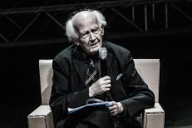
ZYGMUNT BAUMAN
BUROCRACY
In every burocracy we can find elements that helped the Nazists to expand so fast:
FUNCTIONAL TASKS DIVISION
PRODUCTION OF INDIFFERENCE
DEHUMANIZATION AND SOCIAL DISTANCING
SUBSTITUTION OF MORAL RESPONSIBILITY WITH TECHNICAL RESPONSIBILITY
SHOULD WE TOTALLY ELIMINATE BUROCRACY THEN?

Slide 75
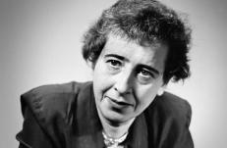
HANNAH ARENDT
RADICAL EVIL
IS TO CONSIDER OTHER HUMAN BEINGS AS:
SUPERFLUOUS, UNNECESSARY
OBJECTS OR NUMBERS ON A LIST, THUS DENYING THEIR DIGNITY AND HUMAN QUALITIES.
BY THIS DEFINITION, DID YOU EVER FIND YOURSELVES "EVIL"?

Slide 76
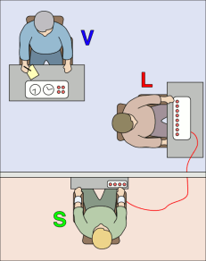
MILGRAM'S EXPERIMENT
CAN WE ALL CARRY OUT UNSPEAKABLE ACTS?
The accomplice must memorize a series of two words read to him (ex. Blue-Sea) and then he's interrogated.
At every mistake the subject must inflict an electric discharge with a button, ranging from 15 to 450V (in 15V increments, for a total of 30 buttons).
Before commencing, the accomplice says he had some minor heart-related issues and that he's worried about the discharges. He's reassured by the experimenter.
The accomplice is not in the same room as the subject and the experimenter.
Discharges are fake.
The accomplice whines and screams following a precise script (after 330V he gave no more life signs)
V = Experimenter
L = Subject
S = Accomplice
HOW MANY PEOPLE DELIVER THE 450V DISCHARGE?

Slide 77
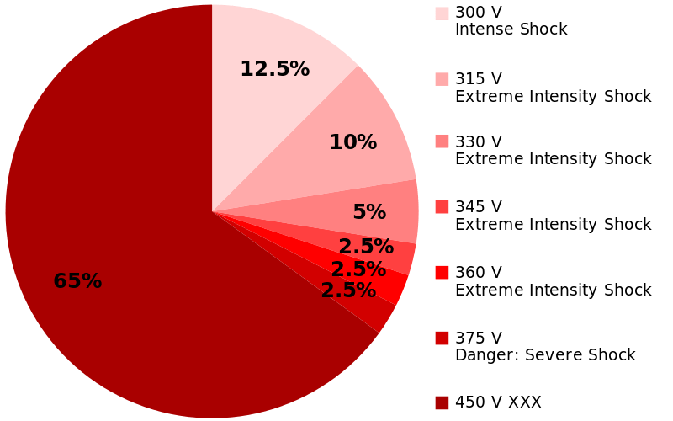
MILGRAM'S EXPERIMENT
CAN WE ALL CARRY OUT UNSPEAKABLE ACTS?
300V
315V
330V
345V
360V
375V
450V
65% OF THE SUBJECTS DELIVERS THE 450V DISCHARGE 3 TIMES!

Slide 78
MILGRAM'S EXPERIMENT
CAN WE ALL CARRY OUT UNSPEAKABLE ACTS?
ETERONOMIC STATE:
Condition where a person no longer considers himself an autonomous and responsible being , but an instrument to carry out orders given by a (perceived) legitimate authority .
In this condition a person feels responsible towards the authority, ma not towards the actions executed in its name.

Slide 79
DISTANCE FROM THE VICTIM AND EFFECTS ON MILGRAM'S EXPERIMENT
 | Distant | Audible | Close | Phisical Contact
 | The victim isn't audible nor visible. | The victim can only be heard. | The victim is in the same room as the subject. | The victim is shocked only if his arm is phisically pushed on a metal plate.
Obedients (%) | 65 | 62,5 | 40 | 30

Slide 80
HANNAH ARENDT
BANALITY OF EVIL
The moment we stop thinking about ourselves and our actions, evil can be emptied of its meaning and can become something habitual and taken for granted. Just banal.
DISTANCE EASES DEHUMANIZATION, WHICH EASES THE BANALITY OF EVIL.

Slide 81
HEINZ'S STORY
A woman is dying because of a rare form of cancer.
The medicine that can save her is a form of radio, discovered by a pharmacist.
The medicine is expensive (200$). The pharmacist asks for 10 times the cost (2000$).
Heinz, the woman's husband, asks for a loan, but only receives 1000$.
Heinz asks for a discount or for the possibility to give the difference at a later time.
The pharmacist refuses.
Heinz steals the medicine.
10 Times the cost, is it right?
Could the pharmacist make an exception?
Is Heinz to blame for stealing th medicine?
LET'S TALK ABOUT IT.

Slide 82
MORAL DEVELOPEMENT according to Kohlberg
Lawrence Kohlberg expands Piaget's theory and describes the moral development of a person in 3 levels, each with 2 stages:
LEVEL 1 – PRE-CONVENTIONAL: Following the rules comes from the desire of avoiding troubles or fulfilling an imminent need.
Stage 1 : an action is wrong when you are punished for it.
Stage 2 : you follow the rules only to gain something in the short period.
LEVEL 2 – CONVENTIONAL: Moral judgement is made based on the rules of the group of peers.
Stage 3 : you follow the rules to maintain good relations and avoid disapproval.
Stage 4 : Authority is respected as an expression of a social and moral order that needs to be preserved.
LEVEL 3 – POST-CONVENTIONAL: AUTONOMY.
Stage 5 : The aim is to build a society which respects the rights of all its parts.
Stage 6 : Superior and impartial sense of justice, inspired by universal and ethical principles of dignity.

Slide 83
BITS OF KNOWLEDGE:
DEONTOLOGY o "DUTY ETHICS" states that the moral value of an action is determined by its adhesion to ethical guidelines, such as a codex of laws or a divine comandament.
Nowadays the word DEONTOLOGY also indicates the rules that regulate a profession.
If what follows the rules is right, is it wrong to disobey?

Slide 84
UTILITARIANISM AND DEONTOLOGY: A REAL CASE
December 2015: an armed attack took place in San Bernardino (USA).
L'FBI tried to hack the suspect's iPhone, unsuccessfully.
February 2016: the court issued an order forcing Apple to modify the security features of the iPhone to allow access to its data.
Apple refused to comply, but sent data and technicians to help the FBI.
FBI leaned hevily on the national security issue.
Timothy Cook, Apple CEO, sent a press release explaining the decision: obeying would have created a precedent that the government could use to force any tech company to create software to undermine the security of its products.
Public opinion was divided as well as all the tech colossi.
ARE YOU WITH APPLE OR THE FBI?

Slide 85
CONSIDERATION: ETHICS OF THE INSTRUMENT
Let's imagine the scariest and deadliest objecy known (es. A nuclear bomb).
Can we say that it's bad? Or good?
A gun on a table is harmless.
What if someone picks it up?
Probably the same gun has a different value for the holder and the person on the other side of the barrel.
Instruments have a neutral morality. Like an action, a word, a gesture.
We give meaning to instruments (and consequently moral value).
LET'S TALK ABOUT IT.

Slide 86
CULTURAL RELATIVISM
Cultural relativism states that moral behaviors dipend on social context and only apply to that specific context: they don't have universal validity.
Morality in a society coincide with social consensus: it's what a society considers acceptable in a certain place, in a certain time.
IS SOMETHING GOOD BECAUSE THE MAJORITY THINKS IT'S GOOD OR THE MAJORITY THINKS IT'S GOOD BECAUSE IT JUST IS GOOD?

Slide 87
SUBJECTIVISM
David Hume states that reason alone can't tell anything for sure about the world.
"Morals excite passions and produce or prevent actions. Reason of itself is utterly impotent in this particular. The rules of morality, therefore, are not conclusions of reason. Reason is, and ought only to be, the slave of the passions." - David Hume
Morality is based on personal beliefs and emotional reactions, not on objective factors.
WOULD MR. ELLIOT AGREE WITH HUME?

Slide 88
BITS OF KNOWLEDGE:
(pro-subjectivism)
With quantum mechanics we know that the observer perturbates the universe that observes. Has science become "subjective"?
Robert Zajonc, in his study on the "Mere-exposure effect" showed how the emotional component comes first when we have to decide what we like or dislike. Does it apply to right or wrong, too?
MAYBE HUME WAS RIGHT AND EVERYTHING IS SUBJECTIVE...
...OR MAYBE NOT!

Slide 89
IMMANUEL KANT vs
DAVID HUME
Man is the only being with a sense of morality and the only one able to reason. Thus, morality must come from reason and must be, consequently, objective.
THE LOGIC IS SOLID...
...BUT WHERE DOES THIS LEAVE US?

Slide 90
"Dio è morto!"
-Francesco Guccini

Slide 91
THEORY OF COMPLEXITY
Edgar Morin
The solutions to a complex system can't be found in the simple solutions of its parts. They require a continuous come and go between a particular and a global point of view.

Slide 92
"Dead are all gods: now we want the overman to live."
-Friedrich Nietzsche

Slide 93
A GLOBAL VIEW: THE MEANING OF LIFE
"We are condemned to be free."
-Jean-Paule Sartre

Slide 94
A GLOBAL VIEW: THE MEANING OF LIFE
LOCUS OF CONTROL
Internal
(Delusion of omnipotence)
External
(Narcissistic disorder)

Slide 95
A GLOBAL VIEW; THE MEANING OF LIFE
The problematic utopia
(Giovanni Maria Bertin)
I World
Egocentrism Eterocentrism
Good Bad
Right Wrong
Internal L.O.C. External L.O.C.
vs
EXISTENTIAL PLANNING

Slide 96
"The free man is necessarily insecure, the thinking man is necessarily uncertain."
-Erich Fromm

Slide 97
Freedom is the chance to choose. In every moment we are called to choose who we want to be, continously.
Our identity is a continuous, neverending, utopic project.
Every moment we are called to be our own leaders.

Slide 98
COMMUNICATION
YOUNG ETHICAL LEADERS
Project nr. 2019-1-FR01-KA201-062991

Slide 99
WHY IS COMMUNICATION IMPORTANT?

Slide 100
WHAT IS COMMUNICATION?
The term "communication" comes from the Latin root communicare, which means to share, to collaborate.
Communication, in general, is a process that is shared in a connection relationship created between the sender and the receiver and is formed by common use. This process begins with the creation of the message by the source person and sends it to the recipient, and ends with the recipient receiving and evaluating this message and responding appropriately.
In communication; There is production, transmission and interpretation of information

Slide 101
WHAT IS COMMUNICATION?
Communication; It is an interrelated message exchange between two units.
Communication is always everywhere; Whether people want it or not, they live in a communication network and it is impossible not to communicate..

Slide 102
Basic Elements of Communication
Source
(speaker)
Coding Meaning
Message
(verbal /
nonverbal)
(karşılıklı alışveriş)
Target
Opening the Code
Feedback

Slide 103
Communication Elements:
Message
connection
Channel
- auditory canal
- visual channel
- sense channel

Slide 104
Code: are the symbols used in the transformation into sign posts.
Encoding: the contents of the message are called to be converted into code symbols.
Opening code: The parsing process

Slide 105
Noise: If there is a difference between the message sent by the source unit and the message received by the target unit, this difference is called "noise".
- physical noise
- neurophysiological noise
- psychological noise

Slide 106
Interpretation: Reinterpretation
Detection: In order for communication to take place, the received and transmitted messages must be perceived.

Slide 107
TYPES OF COMMUNICATION
Verbal Communication
Nonverbal Communication

Slide 108
Verbal Communication
Verbal communications; It can be divided into "language and beyond language". We can accept people's conversations and even correspondence by mail and internet.

Slide 109
Verbal Communication
In verbal communication, people make sense of the information they produce by transmitting them to each other. Trans-linguistic communication is about the quality of the sound. The tone of voice, the speed of the voice, its intensity, which words are emphasized, pauses, and similar features are considered to be trans-linguistic communication.

Slide 110
Verbal Communication
In verbal communication, what people say is important
"How they say" is important in translinguistic communication.
Use of voice and language is important in verbal communication

Slide 111
Nonverbal Communication
A good listener “hears” not only what the person he communicates with but also what he does with his face, hand, arm and body ...

Slide 112
Nonverbal Communication
A good listener “hears” not only what the person he communicates with but also what he does with his face, hand, arm and body ...

Slide 113
Nonverbal Communication
In nonverbal communication, people transmit a number of messages to each other without speaking or writing.
In this form of communication, what people do comes to the fore, not what they say.

Slide 114
Nonverbal Communication
For example, when a teacher encounters an undesirable behavior in the classroom and wants to eliminate it without disturbing the course of the lesson, he or she has to use one or more of the non-verbal communication methods such as facial expression, hand and body movements, eye and body contact.

Slide 115
Nonverbal Communication
Another Example Candy Shop
The boss notices that one of the three salesman girls working in a dessert store is constantly selling while two of them are waiting empty, and asks the secret;
Salesman girl: “The other girls always put more than 1000 grams on the pan of the scale and take back the excess later. I put less than 1000 grams and complete the top later.

Slide 116
Nonverbal Communication
Clients also feel that I am protecting their interests and giving their money's worth, ”

Slide 117
Verbal or non-verbal messages should be consistent with each other
If you say “Yes, I have time to talk to you,” and looking at the clock frequently will destroy your credibility. In conflict between two messages, people usually believe the non-verbal.

Slide 118
Features of Nonverbal Communication:
Nonverbal communication is effective
Nonverbal communication indicates feelings
Nonverbal communication has a double meaning
Nonverbal communication is ambiguous

Slide 119
Features of Nonverbal Communication:
Nonverbal messages do not mean anything alone. Taking the situation in its entirety, there may be a need for more information. Being an expert and honest in your field, paying attention to your appearance and image, helping your subordinates and setting an example; It will enable them to perform their roles well in the organization.

Slide 120
DISTANCE BETWEEN PEOPLE MEANS IN COMMUNICATION
Intimate distance: It covers the distance of 30-35 cm with skin contact.
Personal-intimate distance: distance varying between 40-80 cm.
Social distance: It varies between 80cm and 2m.
Open distance to the general public: distance starting from 2m.

Slide 121
THE FIRST IMPRESSION..
People who have never seen each other before, soon get an impression of each other when they see each other for the first time ...

Slide 122
Your First Impression
messages from the eye 55%
Messages from ear 38%
7% stated that creating content is what people say.

Slide 123
OUR BODY LANGUAGE ..

Slide 124
Facial Expressions
The most striking part of the human body is the face.

Slide 125
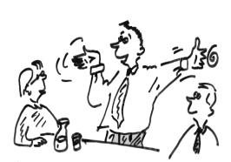
Gestures: Hand and Arm Movements
Hand and arm movements are the most beautiful signs of our emotions ..

Slide 126
Handshake
The way you shake hands is the movements that reveal your status according to the person you face.

Slide 127
Our clothes
The clothes we wear give information about us ..

Slide 128
Speech Style
The style of pronunciation, the sounds used in saying the words, gives information about the speaker.

Slide 129
BODY LANGUAGE CHARACTERISTICS THAT WILL CREATE POSITIVE IMPRESSIONS
Eye contact: People who look at people like it more than those who don't. Establish as many eye contact with people as possible, but to the extent that they don't bother them.

Slide 130
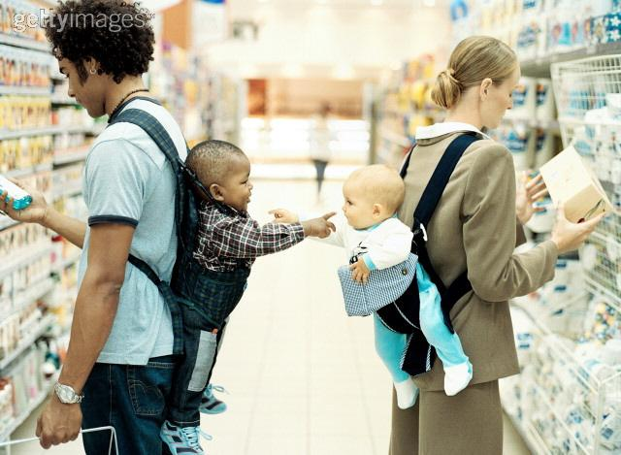

Slide 131

Face expression:
Be alive. Smile and laugh as warmly and friendly as possible, let your face reflect your interest in your surroundings. Avoid looking dull and inexpressive.

Slide 132

Body position:
If you are standing, stand up straight. If you are sitting, fill your chair and seat completely and sit back. When talking to someone, lean forward and show your interest.

Slide 133
Proximity: Always try to stay at the closest possible distance to people that will not disturb them.
Direction: Always stand facing the person you are talking to or talking to you. If you are forming a group with more than two people, do not turn your center off to those other than those that matter to you. Keep your center open to as many people as possible.

Slide 134
Appearance: Dress according to group norms, social role and status. Take care of your hair and hand care. The care you take for yourself is an expression of the value you give to yourself.
Verbal features of speech: Avoid speaking too much and too fast. Try to speak approximately equal to what you are listening to in a community. Adjust the loudness and tone of your voice according to your surroundings.

Slide 135


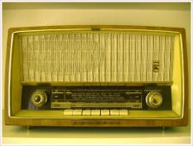



Communication and mass media

Slide 136

Communication is above all an exchange of information.
The purpose of this exchange is to meet the needs of understanding, explaining, learning and receiving education

Slide 137

Mankind, since the day it existed, used various tools to communicate.

Slide 138
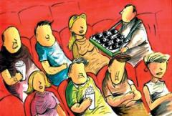
In addition to writing and spoken language based on signs and words, which are considered one of the simplest and most primitive means of communication, body language and non-verbal expressions (gestures, gestures, touching, non-response, behaviours and attitudes such as keeping silent; dance, painting, etc.) have also been used for centuries.

Slide 139


Mass; “Represents all groups and individuals in society.
Mass media: These are the tools that reach a certain audience at certain intervals or continuously, with the aim of providing news and information, as well as educating and entertaining.

Slide 140

Today, communication tools such as mail, telegraph, telephone, fax;
mass media such as newspapers, radio, television;
satellites, computers (Internet and e-mail) have become integral parts of communication as communication tools.

Slide 141
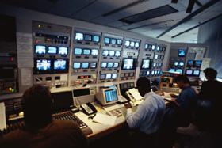
Its aim is to deliver ideas, ideas and news to large masses in a very short time.
Mass media; "It is a tool that gives the opportunity to speak to the whole masses with the use of electromagnetic waves and their receivers to be able to address and communicate with wider audiences."

Slide 142
Mass media has become an element of power in society by fulfilling many public duties such as cultural, economic, educational, political, entertainment, news and agenda.
Some western countries consider the mass media as the fourth power.
At least it is an element of power that concerns the public, such as the legislature, executive, judiciary, and can create public opinion.

Slide 143
Mass media cannot be separated from communication and masses.
Mass media date back to the 15th century when printing with moving metal letters was used in Western Europe.
The mass media began to be used after German Johann Gutenberg found the printing press between 1434-1436.

Slide 144
mass communication has existed and progressed since the existence of humanity.
According to some historians, mass media consisted of 5 stages.
1. Communication with signs
2. Communication with the development of the language
3.Communication with the invention of writing
4. Communication with printed materials with the invention of the printing machine
5. Mass communication with the development of mass media.

Slide 145
Radyo:
We see that the radio first appeared in Hungary at the end of the 19th century as a telephone (wired) radio under the name Budapest Registar.
But the first real radio broadcast was made in 1920 in Pittsburg in the USA.
However, radio technology was used as wireless communication before. For example, when the famous Titanic ship sank in 1912, he sought help with a radio using electromagnetic waves.

Slide 146

Television:
Known as the father of television, Paul Nipkow designed a picture scanning machine in 1884 to transmit this scanned picture over telegraph lines.
The first version of today's television camera was made by Vladimir Zworkin in 1923 under the name ionoscope.

Slide 147

First television broadcast by the BBC in 1936

Slide 148
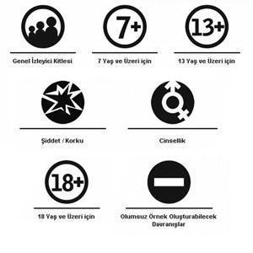

Slide 149
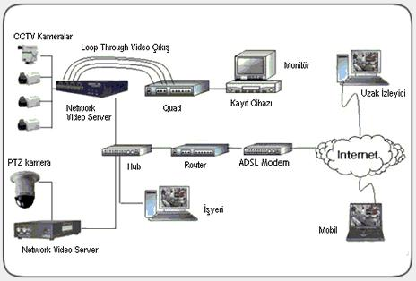
The digital age began with the development of the first computer, named ENIAC, for military purposes in 1946.

Slide 150
Chapter 9: Online Communication
Online Communication

Slide 151
Internet Communication Types
There are many types of communicating online using Internet, including:
Email
Instant messaging
Social networking
Blogs and microblogs
Newsgroups
Forums
Voice over IP (VoIP)
Video chat/videoconferencing

Slide 152
Emails
Email (electronic mail): A computer-based system for exchanging messages through mail servers.
Email is a store-and-forward system: A message delivery system in which messages are forwarded between servers and then stored on those servers until they are picked up.
Mail server: An online server that sends and/or receives email messages on behalf of the email addresses it supports.
  i.e. when you compose and send an email, your provider’s outgoing mail server forwards it to the recipient’s incoming mail server.
Mail client: Software installed on a computer that is used to compose and manage emails.
  i.e. it allows you to access your messages on your incoming mail server

Slide 153
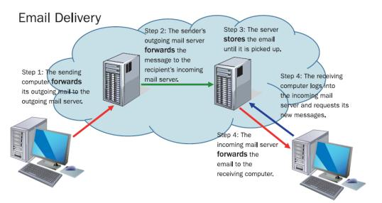
How Email Delivery Works
Email is a store-and-forward system involving mail servers on the
Internet. Mail is forwarded from one mail server to another and then is
stored until the recipient picks it up.

Slide 154
Email Account Types
HTTP email account (Web-based)
    An email account designed to be used with a web interface, and uses web technology for email management
      HTTP* is used for both incoming and outgoing mail
    Examples: Google, Yahoo!
Mail client
An email account that someone pays for, either directly or indirectly.
Examples: the email accounts at your workplace, the accounts that your ISP provides to you, the accounts that you have through a web-hosting service (for example, if you own a domain name)- these all are designed to be used with a mail client.
Two kinds of email accounts designed to be used with mail clients: a POP account and an IMAP account.
  Each uses a different protocol for receiving mail, and offers slightly different advantages
POP Account
  uses Post Office Protocol (POP)** for incoming mail
    POP: it is a store-and-forward protocol - it holds the messages until they are picked up, but it doesn’t maintain any direct communication with the email client.
  Uses Simple Mail Transfer Protocol (SMTP) for outgoing mail
IMAP Account
  Uses Internet Mail Access Protocol (IMAP) for incoming mail
    IMAP: It continues to hold the messages even after they are picked up. Anything done in the email client is reflected on the server
  SMTP for outgoing mail
* HTTP (Hypertext Transfer Protocol): a protocol for web content transmission
** POP3 is the current version of POP

Slide 155
Pull vs. Push Technology
Pull: User must request the content
  Email
  Web browsing
Push: User receives content automatically
  Instant messaging (IM)
  Texting (Sending and receiving short text messages in real-time over a cell phone network)

Slide 156
Messaging
Instant messaging
  Computer-based service
  Yahoo! IM or AOL Instant Messenger (AIM)
  Works on phones, but only with the right app installed
Text messages
  Short Message Service (SMS)
  Works primarily on cell phones
  User may be charged per message on certain plans
Chat rooms
  Public chat, multiple people at once
  May be web-based or application-based
  Internet Relay Chat (IRC) accessible through IRC client software and provides access to huge number of people discussing a particular subject.

Slide 157
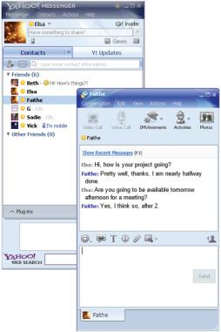
Instant Messaging Example
Yahoo! Messenger’s client
software for Windows enables
you to have one-on-one text
chats with others

Slide 158
Social Networking
An Internet-based system enabling users to interact in real-time and by using messaging programs
Umbrella term for sites such as Facebook, Twitter, LinkedIn, and Google+
User creates a profile and posts status updates, writings, photos, and forwards
Some services use tags, or hashtags (#) which are searchable labels that can be added to posted content allow other people to
find like-minded users
Some social network are specialized (Instagram for photos, Vine for video, Reddit for news, YouTube for video-sharing)

Slide 159
Blogs and Microblogs
Blog: A web page containing personal experiences and opinions, with posts listed most-recent-first
blog platform: A web server that hosts the blogs of individuals, either free or for a small fee. Examples: WordPress, Typepad, and Blogge

Slide 160
Blogs and Microblogs
Microblog: A service that allows the posting of short messages. A status update service such as Twitter, limited to a very few characters per post. Unlike email, microblogs can be seen by anyone and can be commented on by anyone

Slide 161
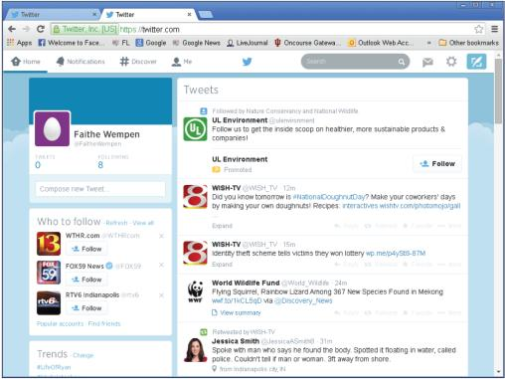
Twitter Web Page Example
Twitter is a microblogging platform used to post frequent
updates and to comment on events as they happen.
Twitter is used by all sorts of people and organizations
to promote themselves and to comment on events

Slide 162
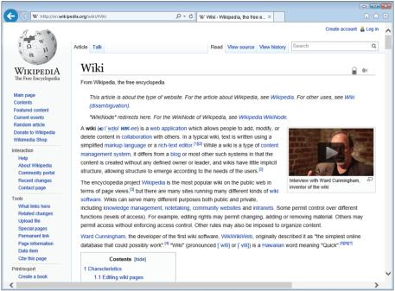
Wiki
An online database of information that is collaboratively edited by the public
A wiki is an online database used for collaborative projects

Slide 163
Newsgroups
Newsgroup
  An online discussion group
  predates the web, forerunners of web-based forums that are popular today
Usenet
  A global distributed discussion system of servers hosting public newsgroups
Newsreader
  An application used by people to read Usenet articles, or an email client that supports newsgroups
  organizes incoming messages from newsgroups and allows users to read and respond to them
NNTP (network news transport protocol)
  transports news articles between news servers and clients reading and posting articles

Slide 164
Forums
Forum
  a web-based discussion and advice- sharing site.
  A more feature-rich type of newsgroup
Users register on the web site so that their posts will be identifiable
A forum thread is a post along with all the comments to it
Many companies have tech support forums for their products

Slide 165
VoIP
Voice over IP (VoIP) is used to make voice calls via the Internet
Turns the voice message into data packets and sends them as if they were other Internet data
IP, short for Internet protocol, is used to identify individual devices that are connected to the Internet and to route calls between them.

Slide 166
VoIP
Skype and Truphone are popular VoIP apps
Some IM clients also allow you to make voice calls
Apps like Skype and Facetime also allow video chat

Slide 167

Videoconferencing
Videoconferencing is feature-rich, group video chat
Can include computer application sharing, voice, text chatting, and document collaboration
Videoconferencing uses the same underlying protocols as VoIP uses, but it requires much more bandwidth.

Slide 168
Personal vs. Professional Communication
Professional communication tips
  Address them formally
  Use polite language
  Avoid abbreviations
  Avoid jargon and slang
  Don’t use emoticons
  Proofread

Slide 169
Personal vs. Professional Communication
Personal
  Don’t make inappropriate jokes
  Talk voice or face-to-face about important or difficult issues
  Avoid discriminatory language

Slide 170
Verbal vs. Written Communication
With whom am I communicating?
What is the context or subject?
Am I likely to need a record of the communication?
Is the speed of communication important?

Slide 171
Choosing an Online Method of Communication
Email
  Used when a quick response is not essential
  Good for formal messages
  Provides a permanent records
Instant messaging
  Quick answers, conveying short messages quickly

Slide 172
Choosing an Online Method of Communication
Social networking (personal)
  Useful for informing friends what is happening in your life
  Good for posting photos and videos of recent events you’ve been involved in
Social networking (business)
  Increasingly used for advertising
  Many social networking sites are dedicated to matching job-seekers with employers

Slide 173
Choosing an Online Method of Communication
Blogs
  Expressing your personal opinions and providing updates about yourself
Microblogs
  Very short summary updates you want existing followers to see
Forums
  Discussing topics of shared interest
  Communicating as part of a community

Slide 174
Choosing an Online Method of Communication
VoIP calls
  Chatting with friends or business associates
  Keeping in touch with families
  Required a reliable high-speed web connection
Videoconferencing
  Appropriate mainly for the workplace or schools
  Allows groups of people to interact visually

Slide 175
Quiz
1 . Name four online communication options available for talking with a friend who lives in
another city.
2 . Give two examples of situations where email should be used to communicate rather than
texting or instant messaging.
3 . Name two video chat clients.
4 . Explain the purpose of an email signature.
5 . What are the advantages of archiving your email?

Slide 176
Official Welcome
1) Round name game.
We will use a rope and you need to tell your name/ make a sigh, hold a part of rope and throw to other person. Other person needs tell your name and make your sight and tell his name and make his sign and through to next person. 10 min
2) 2 Truths 1 lie:
In one pepper, every participant should put 3 things about himself. 1 of these 3, is a lie. No one knows what is the true and what is the lie. They need to mix in the room and they need to guess the right answer.
Go and check for yourself each one it is…
20 min.

Slide 177
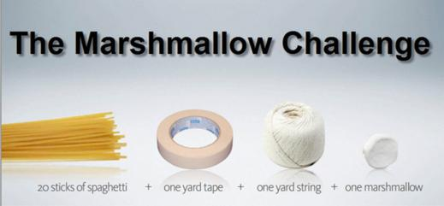
The Marshmallow Challenge -Team building
The task is simple: in eighteen minutes, teams must build the tallest free-standing structure out of 20 sticks of spaghetti, one yard of tape, one yard of string, and one marshmallow. The marshmallow needs to be on top.
Surprising lessons emerge when you compare teams’ performance. Who tends to do the worst? Why? Who tends to do the best? Why? What improves performance? What kills it?
If you need to kick-start a meeting, get a team into a creative frame of mind, or simply want to encourage your organization to think about what it takes to dramatically increase innovation, invest 45 minutes to run a marshmallow challenge.
Step One: Schedule a Meeting
Find 45-60 minutes when your team can fully engage in the challenge. Ensure that you have tables for each team.

Slide 178
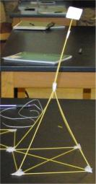
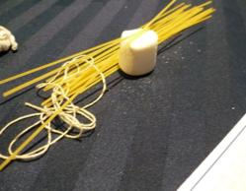

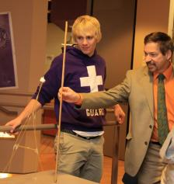
Objective: Build the tallest free standing tower that will support a marshmallow on the top.
Materials :
20 pieces of spaghetti
1 marshmallow
1 yard of string
1 yard of tape
Rules:
Tower must be free standing
Measured from top of table
Only use the materials listed
You will have 20 minutes to build

Slide 179
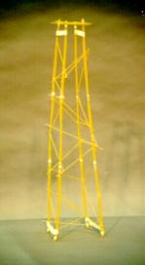
Step Two: Assemble a Kit for Each Team
In advance of the meeting, create a marshmallow challenge kit for each team, with each kit containing twenty sticks of spaghetti, one yard of masking tape, one yard of string and one marshmallow. These ingredients should be placed into a paper lunch bag, which simplifies distribution and hides the contents, maximizing the element of surprise.
Step Three: Deliver Clear Instructions
Be clear about the goals and rules of the Marshmallow Challenge. Use the Acrobat Presentation to introduce the challenge as well as to visually reinforce the instructions:
✦Build the Tallest Freestanding Structure: The winning team is the one that has the tallest structure measured from the table top surface to the top of the marshmallow. That means the structure cannot be suspended from a higher structure, like a chair, ceiling or chandelier.
✦The Entire Marshmallow Must be on Top: The entire marshmallow needs to be on the top of the structure. Cutting or eating part of the marshmallow disqualifies the team.
✦Use as Much or as Little of the Kit: The team can use as many or as few of the 20 spaghetti sticks, as much or as little of the string or tape. The team cannot use the paper bag as part of their structure.
✦Break up the Spaghetti, String or Tape: Teams are free to break the spaghetti, cut up the tape and string to create new structures.
✦The Challenge Lasts 18 minutes: Teams cannot hold on to the structure when the time runs out. Those touching or supporting the structure at the end of the exercise will be disqualified.
✦Ensure Everyone Understands the Rules: Don’t worry about repeating the rules too many times. Repeat them at least three times. Ask if anyone has any questions before starting.
Step Four: Start the Challenge
Start the countdown clock and the music with the start of the challenge.
✦Walk around the Room: It’s amazing to see the development of the structures as well as notice the patterns of innovation most teams follow.
✦Remind the Teams of the Time: Countdown the time. Usually, I call 12 minutes, 9 minutes (half-way through), 7 minutes, 5 minutes, 3 minutes, 2 minutes, 1 minute, 30 seconds and a ten-second count down.
✦Call Out How the Teams are Doing: Let the entire group know how teams are progressing. Call out each time a team builds a standing structure. Build a friendly rivalry. Encourage people to look around. Don’t be afraid to raise the energy and the stakes.
✦Remind the Teams that Holders will be Disqualified: Several teams will have the powerful desire to hold on to their structure at the end. Usually because the marshmallow, which they just placed onto their structure moments before, causing the structure to buckle. The winning structure needs to be stable.
Step Five: Finish the Challenge
After the clock runs out, ask everyone in the room to sit down so everyone can see the structures. Likely, just over half the teams will have standing structures.
✦Measure the Structures: From the shortest standing structure to the tallest, measure and call out the heights. If you’re documenting the challenge, have someone record the heights.

Slide 180
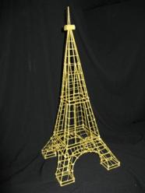
✦Identify the Winning Team: Ensure they get a standing ovation and a prize (if you’ve offered one).
✦Wrap up with the Lessons of the Marshmallow Challenge: Deliver the attached presentation or just describe some of the key lessons of the marshmallow challenge:
✦Kids do Better than Business Students: On virtually every measure of innovation, kindergarteners create taller and more interesting structures.
✦Prototyping Matters: The reason kids do better than business school students is kids spend more time playing and prototyping. They naturally start with the marshmallow and stick in the sticks. The Business School students spend a vast amount of time planning, then executing on the plan, with almost no time to fix the design once they put the marshmallow on top.
✦The Marshmallow is a Metaphor for the Hidden Assumptions of a Project: The assumption in the Marshmallow Challenge is that marshmallows are light and fluffy and easily supported by the spaghetti sticks. When you actually try to build the structure, the marshmallows don’t seem so light. The lesson in the marshmallow challenge is that we need to identify the assumptions in our project - the real customer needs, the cost of the product, the duration of the service - and test them early and often. That’s the mechanism that leads to effective innovation.
Preparations:
✦Spaghetti: Ensure that you use uncooked spaghetti. Avoid spaghettini as it is too thin and breaks easily. Fettucini is too thick.
✦String: Include string that can be easily broken by hand. If the string is thick, include scissors in your kit.
✦Marshmallow: Use a name brand or private label brand of marshmallows that measure the ‘standard’ size, about an inch an a half across. Avoid mini or jumbo marshmallows. Also avoid stale marshmallows. You’ll want squishy marshmallows that give the impression of lightness.
✦Masking Tape: Get standard masking tape. Generally, you’ll want to put the tape on the side of the table, the back of a chair or a nearby wall. Rolling it in the bag tangles the tape.
✦Paper Lunch Bags: Standard size lunch bags work well as do letter size manilla envelops.
Also ensure that you have the following tools to run the challenge:
✦Measuring Tape: Have a contractor’s retractable measuring available after the challenge is finished so you can measure the height of the structures.
✦Countdown Application or Stopwatch: The actual marshmallow challenge takes eighteen minutes. Eighteen minutes seems to be the magic time. Twenty minutes is too long and fifteen is too short. You can use a stopwatch, but better yet is to use a video projector and display the countdown time.
✦Video Projector and Sound System (optional): For more impact, use a video projector to deliver the Marshmallow Challenge Presentation (or your own) and a sound system for music during the challenge. Time out a play list of exactly 18 minutes of music. You’ll want the challenge to end at the conclusion of the last song.
Print: https://www.salto-youth.net/downloads/toolbox_tool_download-file-1051/TED2010_Tom_Wujec_Marshmallow_Challenge_Web_Version.pdf

Slide 181
Ethical leadership skills
Who is a leader?
We most commonly say a leader is a charismatic person who can fascinate others in the right
way and motivate them to be able to overcome obstacles independently.
Characteristics of a leader
At present, the topic of leadership is very popular – after all, who would not want to lead at least
something small. How would you describe such a leader? Would they represent your accurate
image? There are a lot of characteristics today and you may find yourself in some of them.
Leadership skills
To know what to develop, we will introduce the skills or crucial qualifications of a leader in the following text, which we have summarized in eleven groups. Let’s start:
• Analysing and problem solving
• Interacting with people
• Motivating people
• Communication and presentation skills
• Planning and organizing
• Working with information
• Flexibility in thinking and behavior
Team work
Creative thinking
Managing emotion
Openness and perception of feedback

Slide 182
Types of leaders
Autocratic leader
Democratic leader
Leader focused on tasks
Leader focused on relations
Group leadership
Group leadership is in contrast to leading a group by an individual. In this case, more than one person determines the direction of the group as a whole. This approach is being introduced in order to increase creativity and involvement of people.
Interviews with leaders
In the first phase of the project we prepared five audio and video interviews with leader personalities or with our active near-peers.

Slide 183

Your Ethical Leadership Coat of Arms
In this leadership development activity, participants are asked to draw their own coat of arms symbolising the most important elements of their leadership philosophy. The coat of arms drawings are then debriefed and discussed together with the group.
Instructions
In ancient and medieval times, a coat of arms was an emblem - unique design often painted on a shield - to represent an individual person, family or state. Each symbol on the coat of arms represents something that has an important meaning to that person or country. Every leader has certain things and values that they value and find important. Values that guide the leader's behaviour and embodies the leadership philosophy of the person.
In this exercise, participants are asked to create their own Leadership Coat of Arms.
Steps:
Brief participants about drawing their own Leadership Coat of Arms. Explain briefly the importance of consistent values in leadership and ask them to reflect what beliefs and values they find important as a leader

Slide 184
Give a sheet of A4 paper or flipchart and a sharpie for each participant, and assign 10-15 minutes of time for them to draw their coat of arms, representing the 4 most important items they value in leadership. Encourage participants not be concerned about how nice their drawing is, the main thing is expressing what they think is important for a leader.
After everyone finished their drawing, ask participants to share and explain their drawings (you may do it in groups of 4-6 participants, if you have many participants).
Questions to consider:
What items did you add to your Leadership Coat of Arms?
Why are they important for you?
After the discussion and debriefing round, you may ask participants to stick their coat of arms drawings to the wall, so you have a visual gallery of Leadership Coat of Arms
Variations:
You may do this exercise with other focus areas, e.g with Teamwork instead of Leadership. Tips for running this activity online. Pick an online whiteboard tool that allows to use a large, zoomable canvas. Users can either draw their coat of arms on paper and upload an image into the board, or draw it digitally.
In the reflection step, invite users to navigate to the coat of arms of the person speaking. If you don’t have an online whiteboard tool, you can use Slack or Google docs to share and comment on the created images. If using video conferencing software alone, invite the participants to share their screen and show their digital image, or hold up their physical drawing for the group to see. If running the activity in groups, use a video conferencing tool where you can assign the participants into breakout rooms (eg. Zoom). When briefing the exercise and assigning the groups to work together, keep all participants in the main video conference room and explain best practices. After this step is completed, turn on breakout rooms so each group can work on their tasks. After the group breakout groups are completed and participants return to the main room, debrief the exercise. If you do not have breakout sessions, keep everyone in the main room, though invite pairs and groups to communicate in private messages or small groups in Slack.

Slide 185
Leadership Pizza
This leadership development activity offers a self-assessment framework for people to first identify what skills, attributes and attitudes they find important for effective leadership, and then assess their own development and initiate goal setting.
Instructions
Don't we all like pizza? Besides the good taste, this time the slices offer a leadership self-assessment opportunity.
This exercise can help people to reflect on the different dimensions of what skills and attitudes they need in order to be a good leader.
Flow:
1. You start the exercise by presenting the model of the Leadership Pizza: It is a reflection and self-assessment tool where you think about the most important skills and attitudes that you need to master in order to be a great leader.
2. You may present your own version of the leadership pizza to demonstrate an example. Emphasise that your version is just an example, and they should think about what is important for leadership in their own perspective.
3. Assign time for participants to prepare their own set of important leadership skills and attributes, and ask them to draw a pizza shape and label the slices with the items they listed.
4. At this point, you may ask people to share their drawings with the group and explain which labels have they chosen. You may discuss certain decisions and identify common patterns in the group's perception of a good leader.

Slide 186
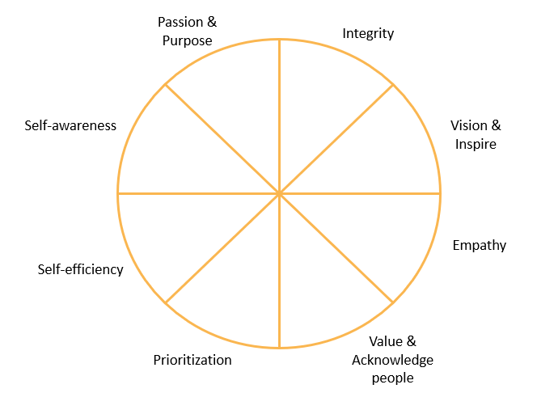
5. Ask participants to assess themselves on a scale of 1 to 10 for each slice. (10 is the edge if the slice, 1 is the core of the pizza). This self-assessment should serve as a baseline for setting up their own personal goals for leadership development. The areas where they find them weaker should receive more focus in their future development.
You may use this tool in coaching and mentoring sessions, too.
Encourage people to set a follow-up action within a few months of time to revisit their Leadership Pizza. They should re-assess themselves, celebrate their development and refine their next goals.
You may use this tool in coaching and mentoring sessions, too.
Encourage people to set a follow-up action within a few months of time to revisit their Leadership Pizza. They should re-assess themselves, celebrate their development and refine their next goals.

Slide 187

Trust Battery
This self-assessment activity allows you and your team members to reflect on the ‘trust battery’ they individually have towards each person on the team, and encourages focus on actions that can charge the depleted trust batteries.
Materials
Trust Battery Worksheets
Instructions The Concept of Trust Battery
Tobias Lütke, CEO at Shopify coined the term: "Another concept we talk a lot about is something called a 'trust battery'. It's charged at 50 percent when people are first hired. And then every time you work with someone at the company, the trust battery between the two of you is either charged or discharged, based on things like whether you deliver what you promise."
The adoption of this concept helps to assess work relations with greater clarity. By measuring the charge on the trust battery, we have the context to frame any potential conflict. A low trust battery is the core of many personal disputes at work. When the battery is drained, things quickly get judged harshly.
A trust battery is a summary of all interactions to date. If you want to recharge the battery, you have to do different things in the future. Only new actions and new attitudes count.
A trust battery is personal: Bob may be at 85% with Alice, and 40% with Jim. While Alice may be at 25% with Bob and 60% with Jim.
So the point of this exercise is to give you and your team an honest assessment about what is your trust battery with other people on the team.

Slide 188
Steps
Explain the concept of trust battery to your participants
Hand out the trust battery worksheets and ask people to write the name of their co-workers on the sheets.
Give a few minutes for everyone to reflect and fill in the trust battery worksheets based on the interactions they had with each person in the past: How much charged is your trust battery towards this person?
Ask participants to reflect on how they may improve the relationship with those people where they
Debrief the exercise with the following questions:
  Why did you place some people's trust battery lower than others?
  Are there relationships where you perceive that your mutual trust batteries are at different levels of charge?
  What actions can you apply to improve on a low trust battery?
  As a leader or a colleague, what can you do to help your colleagues to succeed in charing their trust batteries?

Slide 189
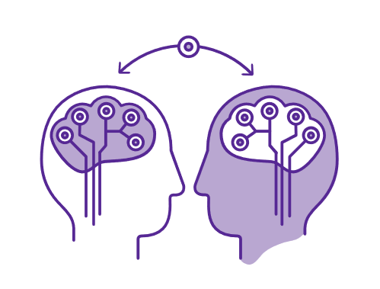
Active Listening
This activity supports participants to reflect on a question and generate their own solutions using simple principles of active listening and peer coaching. It’s an excellent introduction to active listening but can also be used with groups that are already familiar with it. Participants work in groups of three and take turns being: “the subject”, the listener, and the observer.
Materials
Flipchart
Markers
Instructions
Step 1:
Do a brief introduction to active listening. Explain that often, when we reflect and discuss, we tend to focus on multiple individuals and questions at once, moving around our attention and focus. Meanwhile, when we listen to others, we tend to do so in a discussion-oriented way, thinking about “what will I say next”, rather than listening to the other with full presence and attention. One powerful way to explore a question or a problem is to use active listening with focus on one person at a time. For this exercise, this is what we will do.
Optionally, make a list together with the group of “What makes good active listening?” Invite people to spontaneously offer answers and write them on a flipchart.

Slide 190
Step 2:
Using a flipchart, Introduce the three roles that individuals will take on during the exercise.
The subject:
The subject’s role is to explore the question or problem from his/her personal perspective. The person in this role should keep in mind: allow the focus to be on you, and let your reflection flow naturally, being guided by the active listener.
The active listener:
The active listener’s role is to listen will full presence and focus. To listen with the whole body, to be curious, observe, paraphrase what he/she hears and guide the subject with open questions. This person should keep in mind: ask open questions to support the subject’s reflection; do not offer advice; listen with the whole body.
The observer:
The observer’s role is to observe the process without speaking. To make observations from an outside perspective, to see and hear things that the listener and subject may not. This person should keep in mind: stay silent throughout the process; observe and make notes about what you see and hear; after the subject finishes, share the observations with the others.
Step 3:
Set up the question or problem. The question or problem is what each subject will explore and reflect upon. It could be a common question for the whole group (e.g. “What are the biggest barriers to change in my work and how can I work to overcome them?”) or each subject can set his or her own question or problem (e.g. Choose a challenge in the workplace that you are struggling with currently.) Ensure that all participants understand what they should explore and reflect upon.
Step 4:
Have participants organize into groups of three. Make it clear that each participant should have each role for a set amount of time. Give groups one hour or more so that each round can last 20 minutes. Explain that groups should pay attention to the time and make sure that there are three equal rounds.
Step 5:
Once participants have finished, debrief the exercise, using questions like:
What happened for me during the exercise?
How did it feel to be the observer?
How did it feel to be the subject?
How did it feel to be the active listener?
What did I learn about myself?
How can I apply insights from this exercise?

Slide 191



Collage Your Leadership!
Leaders are made, not born, and made more by themselves than by any external means. The most people have the potential to become leaders. The real issue is that leadership takes time to develop. We need time to
- Figure out what am I passionate about?
- Understand our personal values and purpose?
- Learn to express who we are?
- Learn how to use our unique strengths and skills?
- Learn how to express our purpose and our own unique way?
- What is your unique vision and purpose?
- Who you are?
Leadership is not something that you can learn by reading books on leadership. We can not teach you to be a leader but you can learn it trough a hard work. Practice and feedback is important and with training we hope to give you a place for learning and practicing some skills that are significant to become a good leader and to receive positive feedback and constructive criticism that will help you to understand better your strengths and weaknesses and to develop your plan for future learning. We will show you some maps leading to practices that characterize leaders. But you need to find your own compass - sense of vision and direction. Your strengths and success formulas are unique. While given maps and formulas can be helpful for learning the greater reward is in discovering yourself, and understanding your values, areas of passion, personal capabilities, learning styles, energy cycles, and your own way of creating and achieving success. Successful leaders first lead themselves. The main point is to find the role or position in which you feel the most comfortable and can realize yourself, your ideas or your dreams.
Leaders are made when they understand their purpose, their unique strengths. Our differences from others define our success as leaders: a leader needs to know his strengths as a plumber know his instruments. Good leaders know their strengths and are able to use right strength on the right time. There is no one formula that fits all leaders. It is all about finding what makes you different and unique and communicating your uniqueness to others. Because leaders do not follow traditional paths of life. Leadership is means of personal expression. Leaders find ways to express who they are, what they believe, which inspires them to take action towards their vision. We learn and live to express ourselves. When our self-expression is value for others we can become leaders. To be a credible leader you must learn to express yourself in your own unique way. This means that you cannot lead by copying others. You cannot lead by copying actions, beliefs, values and visions of others. You can only lead from your own vision, your own values, your own beliefs and your own actions. People will not follow effective leadership techniques, tools, tricks and tactics. People follow leaders who express themselves who know who they are and who know what they stand for.
Task:
Ask participants to prepare a collage from photos and texts in the magazines that would represent their individual strengths, personal values, passions and something what makes them unique. After 30 minutes preparation the participants take place in the circle and introduces their collages to the rest of the group.
Old magazines as many as possible
Glue
A4 color sheets
Scissors

Slide 192

Ethical leadership problems, needs, objectives, vision
The participants will be divided in 4-5 groups where they have to write the ethical leadership problems, needs, objectives, vision. After every 5 minutes they have to change and only the leader will stay at his place and will not change the group. This will be a brainstorm method. After that groups will come back to their places and will have to present what everibody wrote on the flip-chard in most interactive way (creative way) 15 minutes for preparation. After they will present the resultes. At the end will be discussions.
http://www.virtueventures.com/files/mdbl-chapter2.pdf

Slide 193
Inspirational and Motivational Techniques for self-employment
1. Youth unemployment and consequences on youth
Presentation of what unemployment is: https://www.youtube.com/watch?v=K1J3diJsD9U
What Is Unemployment?
Unemployment represents the number of people in the work force who want to work but do not have a job. It is generally stated as a percentage and calculated by dividing the number of people who are unemployed by the total work force.
People can be unemployed for many reasons:
They quit their position and are looking for a new one.
They were laid off due to lack of work and haven't yet been rehired.
Their company reduced the work force, and they are seeking a new position. This can be due to a local condition, when the company closes a plant or division, or a national condition, when the economy slows and many companies reduce their work force.
They have recently returned to the work force - perhaps from pregnancy or attending school - and haven't yet located a position.
The need for their skill set has gone down, and there are limited positions available, which may lead to unemployment until they train for a new position.
Technology has reduced the need for their type of position.
Unemployment is defined as a situation where someone of working age is not able to get a job but would like to be in full-time employment.
One grey area is voluntary unemployment. This occurs when the unemployed choose not to take a job a the going wage rate (e.g. wrong job, benefits too high e.t.c) They could be counted as unemployed because they are still seeking a job (they just don’t want to take one they are offered.

Slide 194
Unemployment is defined as a situation where someone of working age is not able to get a job but would like to be in full-time employment.
One grey area is voluntary unemployment. This occurs when the unemployed choose not to take a job a the going wage rate (e.g. wrong job, benefits too high e.t.c) They could be counted as unemployed because they are still seeking a job (they just don’t want to take one they are offered.
Types of unemployment
Summary of Unemployment types
Demand Deficient Unemployment. – Lack of aggregate demand in economy (e.g. unemployment rises in a recession)
Structural Unemployment – workers lack necessary skills or suffer from geographical immobility
Real Wage Unemployment – wages above equilibrium, e.g. due to high national minimum wage.
Frictional unemployment – workers in between jobs
Voluntary Unemployment. – workers prefer not to work
The participants will be devided in groups of 6 (by numbers). Participants in groups have to act as a short theatrical performance the consequences of youth unemployment on personal level. They have 20 minutes to prepare. They are encouraged to share their personal experience too. After performances, there is a small discussion explenations.
In what country this happened?
Can people guess each other’s roles?
Did anyone feel that there were moments when their basic human rights were being ignored? How easy or difficult was it to play the different roles? How did they imagine what the person they were playing was like?

Slide 195

Youth unemployment and consequences on youth
The participants remain devided in groups. The aim are using non-formal learning for creating better opportunities for unemployed young people for self-development and, in the long run, for returning to work and getting involved in community life. Among many of the exercises run in this training course, this one will be devoted to analysing the pros and cons of unemployment. Following is a brief overview as identiﬁ ed by participants at this training course. Participants have to work in group and devide his flip-chard Pros of unemployment and Cons of unemployment. Trainer will take notes when a leader per group will come and read the statements. https://www.salto-youth.net/downloads/toolbox_tool_download-file-785/WorkingOnWork.pdf

Slide 196
EXAMPLE OF HOW TO ENFORCE POSITIVE THINKING. An exercise “Pros and cons of unemployment” from a training course The national training course “Getting young jobseekers involved through non-formal learning” has been organised by the Estonian National Agency of the Youth in Action Programme, Foundation Archimedes, in 2007. The training event focused on how to use non-formal learning for creating better opportunities for unemployed young people for self-development and, in the long run, for returning to work and getting involved in community life. Among many of the exercises run in this training course, there was one devoted to analysing the pros and cons of unemployment. Following is a brief overview as identifi ed by participants at this training course: Pros of unemployment: • a wish and motivation to change your life • lots of free time • hope for a better future • time to think about yourself • choices you can make without being afraid to “lose” something (in professional life) • new experiences • a time for hobbies, to be with family and friends • a possibility to sleep longer • an opportunity for self-development • time to take part in training etc The example of this exercise shows that with suffi cient support (for example by individual coaching etc), the period of being unemployed can provide a very signifi cant learning experience and serve as a way to better recognise yourself as a personality and your resources.
Cons of unemployment: • a decrease in self-confi dence • facing fi nancial diffi culties • fear and uncertainty • inability to keep up with new knowledge • stress which could lead to different illnesses etc • relationships which suffer from personal diffi culties • depression • no sense of belonging • too much free time

Slide 197
Elevator Pack
If you are lucky enough to be in an elevator with a key potential donor or investor for your social enterprise—in other words, you have their undivided attention—what would you say to them? 60 minutes In the second, the so-called Business Idea Generator, participants (individually or in small groups, according to their preferences) will figure out a business idea suitable for the local communities. The team of trainers will provide a set of recommendations to ease the process and come out with meaningful ideas. Once generated the ideas, participants will be asked to briefs present them to the group. The format of the presentation will be an elevator pitch, following the learnings of the „Effective Communication“ workshop. In order to refresh the learnings of that activity , a compilation of tips & suggestions will be recalled in order to perform the elevator pitch in the most effective way. Each business idea will have barely two minutes to be presented.

Slide 198
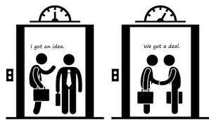
Elevator pitches should be no more than 2-3 minutes. Please address the following questions:
1. What social problem you are addressing with your enterprise?
2. How will your enterprise solve or mitigate this social problem?
3. Who is your customer?
4. What is the product(s) or service(s) you are offering?
5. Who is behind the social initiative —key management, advisors and other stakeholders?
6. What is your advantage over others doing something similar?
7. How will your enterprise be sustainable?
8. What do you need (from the potential investor) to start or grow your enterprise?
9. Why will you succeed?

Slide 199
Social responsibility?
Social responsibility is a means of achieving sustainability. Adopting key social responsibility principles, such as accountability and transparency, can help ensure the long-term viability and success of any organization or system.
The responsibility of an organization for the impacts of its decisions and activities on society and the environment, through transparent and ethical behavior that:
Contributes to sustainable development, including health and the welfare of society
Takes into account the expectations of stakeholders
Is in compliance with applicable laws and consistent with international norms of behavior
Is integrated throughout the organization and practiced in its relationships

Slide 200
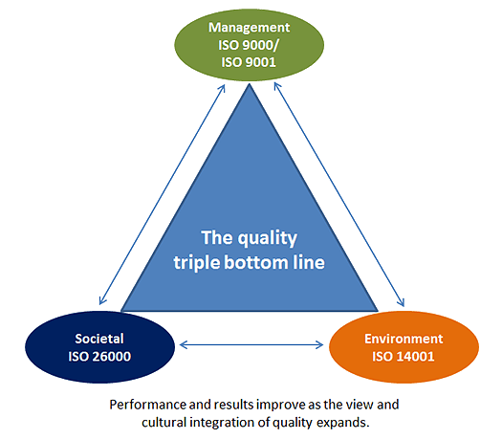

Slide 201
CORE SUBJECTS AND KEY PRINCIPLES OF SOCIAL RESPONSIBILITY
Guidance on Social Responsibility identifies seven core social responsibility subjects:
Organizational governance
Human rights
Labor practices
Environment
Fair operating practices
Consumer issues
Community involvement and development
In addition to the core subjects, ISO 26000 also defines seven key principles of socially responsible behavior:
Accountability
Transparency
Ethical behavior
Respect for stakeholder interests
Respect for the rule of law
Respect for international norms of behavior
Respect for human rights

Slide 202
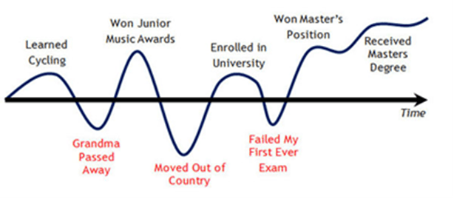
Self-awareness
Trainers will use different methods that will support participants to clarify their life values, characteristics and future dreams. In this exercise, participants will get to examine their past and represent it in a visually exciting way. It encourages individuals to open up and share what they think of their most important experiences in life, values and futre dreams/plans. Ideally, it is better to carry out this exercise after other exercises or ice breakers so that delegates would have become more familiar with each other before participating in this exercise.

Slide 203
Introduce the image of your life’s spiral – from birth to the present moment [in full group]
2. Describe how, in the course of your life, as with everyone else, there have been points in your life where you have come into contact with people (one person/many people) who you regarded as different to yourself – this could be at any age. Describe three personal examples (and mark them on the spiral according to your age when they occurred) – what were the situations, how was the person(s) different and how did you respond? [in full group]
3. Ask each participant to spend 10 minutes reflecting and trying to identify 3 such experiences in their own lives (according to how they have identified “difference”). They may wish to make notes – or not. [individually]
4. Ask participants to find a partner and spend 10 minutes describing and sharing these experiences.
5. Choose one of the three examples you gave previously and describe the influences on you which affected your response, in terms of your emotions and your understanding – who had been the formative influences on you – mum/dad/carer/other adult – family/aunties/uncles/grandparents/others – school/college/other friends – education teachers/school etc – media TV/ newspapers/music/internet – peer influences – cultural influences – BE SPECIFIC.
6. Use a visual diagram or model to depict and demonstrate this to participants. I would choose to use the example of the solar system (which participants could draw or represent in another way) – the situation you choose to describe can be symbolised as the sun and the influences can be shown as the planets. The planets can be shown further or nearer to the sun according to their influence on the situation, and each planet can then be divided according to how much it represents a positive or negative influence (like the dark and light side of the moon). The planets also have interesting features like several moons or rings around them – features which could be used to symbolise a variety of things; for example, if the positive/negative separations are not sufficient to express a particular influence, moons could be used to represent different degrees of influence (strong, medium, weak), and rings could be used to demonstrate a vague memory where it is difficult to recall accurately etc. [full group]

Slide 204

7. Ask each participant to choose one of the three experiences they identified previously and to design a similar diagram or model (solar system or something which fits how they want to show things better). I still think that the same diagram achieves a common understanding in the group and makes comparison and contrast easier. [individually]
8. Ask participants to separate into groups of 5 people and share their diagrams or models – display and explain the diagram/model to the other group members. [small groups]
9. Now ask each group to discuss how their individual views of their experience have changed - what and who has influenced that change – what and who have been the positive and negative impacts in that process – what have been the important influences or factors in changes or confirmation of opinion? Perhaps you could give participants 5 minutes individually to reflect on this before group discussion. [small groups]
10. Now ask each group to decide on a format for representing these views – this could be a format involving the group feeding back as a whole or the group feeding back through individual expression/presentation. Giving the participants this choice allows for a variety of response and a choice of methodology. [small groups]
11. Finally, ask each group to present (i.e. make a presentation or explain their method of presenting their views). How long you allow for this will depend on the time allocated to the overall activity.
What did you think of this exercise?
What did you learn from your life curves?
Which areas do you want to repeat again?
Which areas do you want to avoid?
What does this mean to your life?

Slide 205

10 Essential Networking Strategies
Whether you are a corporate employee, self-employed professional or entrepreneur, climbing the ladder to success can be easy if you are committed to consistently following a few simple networking strategies in your career.
Here are 10 networking and business tips to help be successful:

Slide 206
1. Build Your Networking
2. Develop Thick Skin
3. Be Nice to Everyone You Meet
4. Be Giving
5. Grow Your Relationship Database
6. Communicate
7. Keep it Simple
8. Build Rapport
9. Set Goals
10. Access Available Resources

Slide 207

Creativity Techniques -Time to dream and envision
1. Brainstorm about:
- What is ART for YOU?
- Presentation of 7 Arts.
- Explain how much Human kind expressed themselfs trough out arts since we exist.
2. Presentation of the 7 arts Power Point!
7 arts are presented!
- Architecture
- Sculpture
- Painting
- Music
- Dance
- Poetry
- Cinema
Motivation! Inspiration! Direction! Dream and Fulfillment!
https://www.facebook.com/photo.php?v=10200183372965447&set=vb.371583629589684&type=3&theater
Choose to do different. Choose to be you. Choose your dream and not the money. Be yourself and do what you like the most.

Slide 208

ShaleskafART City challenge
First step is to separate by groups and explain that they will have to present the plan they prepared after is created. This means explore themselves. Make them understand the how lack of possibilities and the lack of expressing themselves can affect the fact that they don’t express themselves 100%! 3 groups are made. By random choice.
Give same case to everyone:
Each of the groups is a group of artists. They need to develop the city as situation as the city is bad they have no tourists and no more new ideas are born. They are thinking about involving through arts in order to create a cultural center an easily access to European founds on this matter.
Now they are three groups of artists that need to elaborate a project in order to make a great city. So what they will do is to use their skills in order to be part of the plan of the structure and future artistic vision of the city. They believe that applying their skills to what the city wants, they will find success.

Slide 209
The city was built on an Island and every year tourists from around the world went to visit it. It was known as one of the most rich and inspirational cities of the world. For a long time the city was rich and prosper due to tourism.
But with time, also the city of Shaleskafar was a victim of the modern times. It started to loose it’s power and well being as a city. The population started to go away and new ideas weren’t born anymore.
The mayor realized that the city needed a new strategy and a new element capable of bringing again tourism and new habitants.
He thought about gathering new founds in order to make a bet on a new approach on creativity for the city.
A budget was prepared and a contest was launched. Only arts were allowed to be in contest. The most brilliant and consistent idea will have the chance to implement it in Shaleskafar.
You, as a creative… (group of people/you decide what) have the task, goal and motivation to revive the city of Shaleskafar!
Be creative!
It’s time to make dreams come true!

Slide 210
What’s On Your Desk Creativity
After presenting the participants form two new groups and then tell them that one of the 20 items is going to be their new product, and that they must come up with a name, logo, slogan, and marketing plan for that object. Give them a set amount of time. Once the time is up, allow each person to present the item and give a two minute presentation on their “product” as if they were selling it.
Discuss, as a group, which products were successfully sold and why.
PURPOSE
For marketing and design teams, this exercise presents the challenge of seeing old things in a new light. When combined with groups working together to sell a common object, you introduce teamwork and crunch-time brainstorming. It promotes creativity and problem solving, too.
Active Listening and Clear Presenting
Bring your team in for what they think is just another staff meeting. Have a long document filled with mind-numbing but coherent jargon-filled speech that talks vaguely about sales and marketing goals. Sprinkled in the document are sentences which say something else entirely. These sentences should contain instructions or information that they will be quizzed on after you are finished. Begin reading it to your team in monotone. The goal is to get them to tune you out. Do not over- emphasize the “real” sentences. When you are finished, hand out blank paper to each team member. Then, ask them to write down what they thought you talked about. If your real sentences contained random information, quiz them on that. Discuss who heard what, and see who was able to actively listen.
PURPOSE
This exercise touches on conflict resolution with the idea that many conflicts arise because team members don’t really listen. It shows the importance of listening to verbal communication, but also non-verbal communication. They can discuss why they tuned you out, and what you could have

Slide 211
Sinking Sands: Description, Grid and Debriefing Questions
Giving a group a challenge in which it has to co-operate to achieve the task and having a look at how the group worked together and could even work co-operate better in the future (especially during your course).
Description : As the story goes, you went for a walk in the forest with your group, and got lost. It is getting dark and you need to get back home before night falls. The only quick way back is through the “Sinking Sands” (the grid on the floor – see below). The whole group has to cross the sinking sands by trial and error (the facilitator who has the path through the sands on a sheet of paper will make a bloob bloob noise when someone sinks). There is only one correct path through the sands and all steps are adjacent.
Since the sinking sands are very fragile, only one person at the time can be on the sinking sands otherwise both sink. If someone sinks the whole group has to start again, as the aim is to have the whole group alive on the other side. You can not leave any traces (marks or objects indicating the right path) on the sinking sands, nor write down the path. And last but not least, because there are ghosts in the sinking sands, from the moment that the first person starts trying, no sounds are allowed anymore, in order not to wake up the evil ghosts…
After this explanation (which can be made fun with a little bit of creativity) the group has 5 – 10 minutes to negotiate a strategy on how they think to do the task. It is important during this time to observe the decision making and problem solving process in the group (or ask some observers to do this – participants that have already done this exercise for example). When they are ready they can start and the facilitator reinforces (and possibly has to repeat) the rules and indicates the errors, until everybody has crossed (and jumps in the air of joy).
The most important part of this exercise is the debriefing for which you can find some questions below. It is important in the beginning of the debriefing to leave some space to let the steam of the kettle and get rid of the vivid emotions or frustrations (a round in which everybody can say one word or make one sound about the exercise – or a common shout or shaking off the game).
The next couple of questions could be about the exercise in itself and their solution: what worked and what not? But soon it is time to move on to questions of observation of the group process: how were decisions taken? Different roles in the group? Here the observers can provide interesting anecdotes they have seen in the heat of the discussion. Important is not to judge people (X is dominant), but to talk about concrete behaviours (in this situation at that particular moment X forced through his solution).
And the most important question probably is: what can we learn from this exercise for this training course or for real life? This could lead into establishing a code of conduct, which could be noted down on a flipchart and hung on the wall.

Slide 212
💣 : Pitfalls : Since this exercise is very involving and exhilarating once succeeded, the facilitator needs to do some extra effort to keep the debriefing under control and allow for all participants to speak (asking questions directed at certain people or having (half) rounds in which everybody has to say something short).
If you split in two smaller groups, allow for the second group to finish the exercise. It is frustrating to be halfway through a task and not to allow them to finish. During the debriefing, the question could be raised how it felt to be ready first or last?
⮚ Outcome : An example of a Sinking Sands Grid (you can adapt it in size and difficulty) but 8 X 8 is a good size.
Debriefing suggestions:
How did you feel during the exercise?
What was the group atmosphere like?
What made the group going? What worked?
What made the group block? What didn’t work?
How did you make decisions in the group?
Was everyone involved in the decision making process?
Did you make rules? Were the rules common to everyone?
How did you feel the group? Supportive, pressure,…?
Did you see the difference in acting between the people that were focused on the process (caring about the group) / task (achieving the aim)?
How could we have done the task more pleasantly / more efficiently?
What can we learn from this for the organisation of an international Youth Activity?
 | 1
 | 2
 |  | 3 | 4
 |  |  |  | 5
 |  |  | 6
 |  |  | 7 |  | 9
 |  |  |  | 8 |  | 10
 |  |  |  |  |  | 11

Slide 213

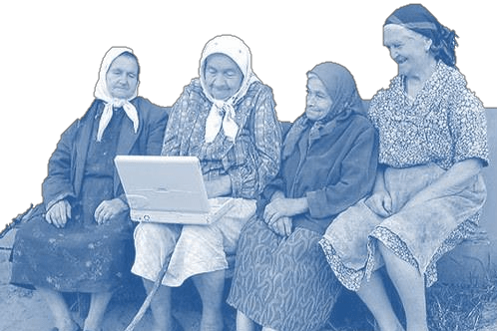
Ethical communication
If someone ask you „What is Communication?“, what would you say?

Slide 214

SIX ELEMENTS OF A MESSAGE:
If a message is to be successful, it must have certain characteristics:
Clear
Consistent
Unique
Convincing
Truthful
Important
Emotional
K.I.S.S.
1) Keep it short and simple!
2) Keep it significant and sharable!

Slide 215
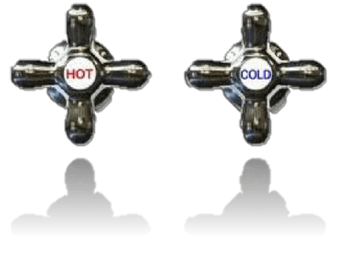
Channels of communication
„The medium is the message”
- Marshall McLuhan
Hot Medium:
Extends single sense in high definition
HD=well filled in with data, sharp, detailed
Little audience participation required
Examples:
photograph
radio
phonetic alphabet
print
lecture
film
books
Cool Medium:
Extends to more senses
Low definition
Offers little information
Requires recipient to fill in missing information
High participation
Examples:
cartoon
telephone
ideographic/pictographic writing
speech (orality)
seminar, discussion
television
comics

Slide 216
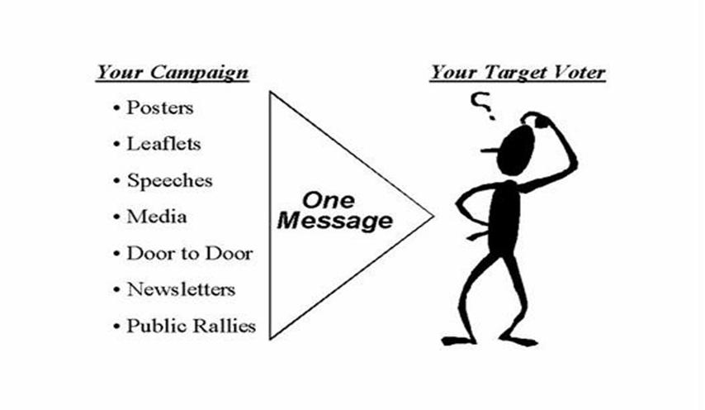

Slide 217

WHAT ARE SOCIAL MEDIA?
Social media is a dynamic online medium that has changed the way we work. Similar to traditional media, social media offers opportunities to collect and share news, communicate with audiences and advocate for change. However, unlike traditional media, social media allows for this to happen on the Web in real-time through highly interactive global or regional social networks.
It is important to remember that traditional media ethics rules apply to social media. Nothing said or done on social media is truly private. Anything you post is a direct reflection of you or the organization you represent.

Slide 218

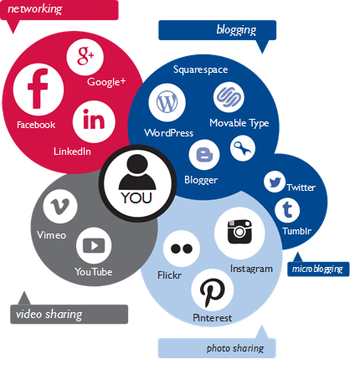
There are over 2 billion social media users worldwide!
There are a wide range of social media platforms, from social networking sites designed to link people with common interests through an online community to sites designed purely for photo and video sharing. These platforms are constantly evolving and new platforms are emerging daily. There are a variety of options available to suit a range of individual needs.

Slide 219
SOCIAL NETWORKING SITES
A social networking site is an online community that allows users to create a profile and cultivate a social network of friends and followers. Users may communicate with others in the network by sharing ideas, activities and events through updates and photos.
With over one billion active users, Facebook is the most popular social networking site globally, but there are also many other sites that cater to regional or personal interests.
In China, for example, Tenecent Qzone is a widely popular social networking site while in Latin America, Orkut is among the most popular social networking sites. VKontakte is very popular among Russian speaking countries with over 300 million users.
Twitter and Tumblr are other social networking sites with global popularity, otherwise known as microblogging sites.

Slide 220
SOCIAL NETWORKING SITES
LinkedIn is an online social network for business professionals. It’s different than other social networking sites because it’s designed specifically for professional networking -- finding a job, discovering sales leads, connecting with potential business partners -- rather than simply making friends or sharing media like photos, videos and music.
Tumblr is a microblogging platform and a social networking website. This service allows users to post different thing in a form of a short blog. There are no length limitations on Tumblr posts, but the culture of this site it is based on short updates and many users stick to this format.
Pinterest is all about collecting and sharing different things we find on the internet. It is a kind of digital bulletin board or a scrapbook. Pinterest helps you to organize and save easily whatever you discover online.

Slide 221
BLOG
A blog, short for Web log, is an online communication platform through which a blogger (the person who submits content to a blog), can regularly share stories, photos, videos or links according to the subject matter of the particular blog. It is often likened to a journal, because most blogs are written in first person and offer a more personal narrative compared to content traditionally found on a website.
Blogs are a valuable tool for development because they allow organizations to easily expand beyond their traditional communications mediums and social networks, and curate a content rich platform for their followers. They are also a great venue to share other news or information, relevant to the organization and its partners or stakeholders.

Slide 222

BLOG
As with other forms of social media, readers can interact with bloggers by commenting on blog posts. They can also subscribe to a blog to receive notifications as soon as new posts are published. Blog posts appear in reverse chronological order, with older posts archived for reference. Blogs facilitate easy updates, which encourages organizations to frequently generate fresh content.
Some of the popular blogging platforms include: WordPress, Movable Type, Blogger, Tumblr, Squarespace and Typepad.

Slide 223

WIKI
A wiki is a special web application that allows open content editing by users, thus encouraging the democratic use of the Web. Users can add, modify or delete content in a collaborative environment. The owner of a wiki can choose to allow open editing or limit editing to only those who have an account or special permissions.
Wikipedia, an online encyclopedia produced collaboratively by volunteers around the world, is the most popular wiki.
Many companies and organizations have launched wikis to compile documents and information into a unified whole, allowing staff and stakeholders to edit and contribute to the knowledge base.

Slide 224



PHOTO AND VIDEO SHARING SITES
Photo and video sharing sites have become increasingly popular with the proliferation of smartphones.
The sites host user-generated photos and videos that users can upload to their profiles. The most popular video sharing site is YouTube, which requires a user account to upload videos. Though, anyone can view videos posted on YouTube.
Vimeo is another platform to upload and share videos. Popular photo sharing sites include Flickr, Instagram, Vine, Snapchat and Pinterest, each catering to a different niche. Some photo sharing sites also allow users to post videos.

Slide 225
PHOTO AND VIDEO SHARING SITES
Instagram is an online mobile photo-video sharing social networking service which enables its users to take pictures, videos and to share them online with the others. Instagram is considered as vintage photography smartphone app.
Snapchat is video messaging application which allow users to take photos, record videos, add text and drawings, and send them to a controlled list of recipients. These sent photographs and videos are known as "Snaps". Users set a time limit for how long recipients can view their Snaps (as of September 2015, the range is from 1 to 10 seconds), after which they are deleted from Snapchat's servers.
Vine is a short form of video sharing service. The service allows its users to share seven second video clips and share them with the others.
Flickr is a photo and video positing website. The site allows its users to share and search photos. The service is widely used by photo researchers and bloggers.

Slide 226








POPULAR SOCIAL MEDIA PLATFORMS

Slide 227

www.facebook.com
Facebook is the world’s largest social networking site. It allows users to engage with people and brands through a very interactive experience. Individuals can create a personal profile Page, while public figures and entities can create public pages. Both options allow users to share photos and videos, plan and promote events, post news or information through status updates, and like or comment on posts. Each time a user engages in these activities, it becomes visible in their friends’ or followers’ news feed.
Organizations can promote their cause and build a community of advocates through Facebook’s open and dynamic interface. They can use high quality photos or visuals to brand their Page and add customized apps to drive followers to their blog, website or other online networks. Organizations can also choose to create a Group in addition to a Page, where they can foster dialogue on a specific topic and have more flexibility with privacy settings.
1.49 billion monthly active users!
!
Correct usage:
Profile – for real person
Page – for organisation / company
Group – for people with common interests

Slide 228

What can you do on Facebook?
1. Create a Facebook Page for your organization
2. Maintain a timeline of activities, events and milestones
3. Actively engage fans with status updates, photos, polls and videos
4. Build a community of fans and advocates, and foster meaningful conversations
5. Drive fans to strategic virtual destinations by offering links to your organization’s website, online resources, surveys or blogs
6. Follow other organization’s Pages whose missions align with yours

Slide 229
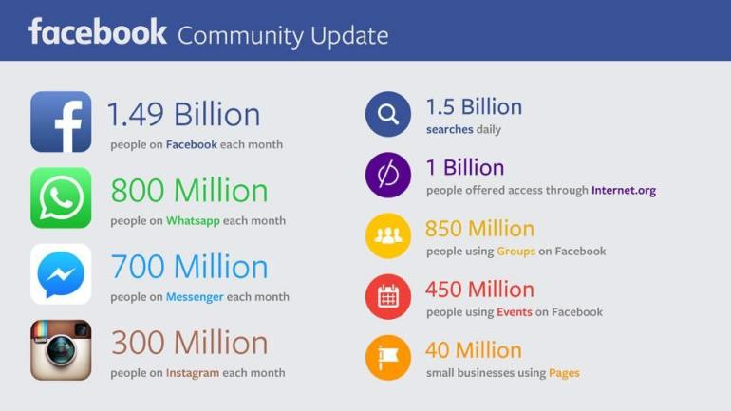
The Facebook family is constantly growing

Slide 230
When using Facebook:
As an organization, you should have a page not a profile. Profiles are for individuals.
Update your Facebook page as often as you can, with the latest news and issues that you would like to share with your community.
Keep Facebook posts rather short and conversational, and if possible include an image
Encourage the dialogue and discussion through wall posts, status updates and news feeds.
Post stories about issues that concern you
Share photos, videos, links that could be interesting to your community
Create Facebook events to advertise meetings, events, campaigns that you are organising, invite as many friends as possible

Slide 231
Facebook page insights (Facebook analytics)
Facebook’s Page Insights offers page administrators valuable Page insights through dynamic and interactive graphs and visuals. The data can be accessed simply by visiting an organization’s Facebook Page and looking for the tab that will direct you to the Page’s Insights.
1. Examine peaks and valleys for Likes on the Page
2. Examine engagement rates and reach for each post
3. Determine the best time to post by reviewing when your fans are online
4. Export data to archive and analyse insights offline

Slide 232
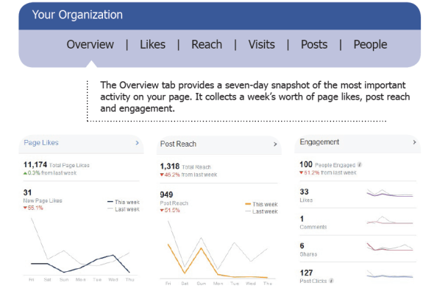
Facebook page insights (Facebook analytics)

Slide 233

www.twitter.com
Twitter is a social networking and microblogging site that offers a very simple interface to quickly share and discover information. Twitter has over 500 million users.
Users can create a profile, gain followers and follow others. Twitter posts are called Tweets and are restricted to 140 characters. Within the 140 character limit users can share text, links, images or hashtags (#) for categorizing content.
They can also favorite, retweet, or reply to a tweet. Popular users gain millions of followers.

Slide 234

www.twitter.com
1. Create a Page for your organization or for your profile a private one
2. Regularly share relevant updates or photos
3. Drive followers to strategic virtual destinations by offering links to website, online resources, surveys or blogs
4. Engage in direct conversation with followers by replying to their Tweets
5. Follow trending topics with hashtags relevant to your interests
6. Provide your followers a real-time sense of what is going on by sharing timely Tweets

Slide 235
When using Twitter:
Share short posts on Twitter, up to 140 characters, but don’t use all 140 characters – leave some space for others in case they want to re-tweet it and add something
Encourage followers to take specific actions related to your goals which should be clear and simple
Tweet directly to ones that you would like to collaborate and be partner of your initiative
Engage in discussions with others
Be active and creative while posting - this way you will draw attention of more people
Reply to Tweets addressed to you
Use special websites (tinyurl.com) to cut your link – this will save a lot of space out of your 140 characters
Use hashtags! (not more than 3)

Slide 236

www.youtube.com
Sometimes, even more important than telling an audience the impact of a special program, is showing them through video. YouTube is the leading video sharing site in the world. It offers visitors an opportunity to discover videos on virtually any topic, produced both by amateurs and professionals alike.
You can create channels, much like profile pages on other social networks, to curate their own videos and subscribe to and follow other channels. Videos can be uploaded easily, with an option to take advantage of video editing tools already built into the system. With appropriate titles and keyword tags, searching for videos is made very easy. Once a video is on YouTube, it can be embedded onto other online platforms such as websites or blogs, making it even easier to share.

Slide 237
www.youtube.com
1. Create a YouTube channel
2. Share promotional videos, mini-documentaries and emotional appeals for support
3. Build a base of subscribers with whom you can engage
4. Promote special events and drive visitors to online destinations
5. Subscribe to other channels and search for videos that align with your organization’s objectives

Slide 238

www.plus.google.com
Google+ (Google Plus) is a social networking site that is integrated through a person’s experience on Google. It offers many levels of engagement and includes features that can help a user target a message to a segmented audience by grouping followers in Circles.
It also allows users to host live video chats via Hangouts for small, private chats or Hangouts on Air for broadcasting large video chats to an unlimited audience. The Hangouts can be recorded through YouTube and saved for future reference. Google+ also offers dynamic searching capabilities. Users can easily conduct a search on a certain topic and view returned results from posts by other users in Google+ or anywhere on the Web.
Google+ is the biggest „dead” social network with almost 2.2 billion profiles of whom only 111 million are „active” (only 6.7 million users had 50 or more posts ever). But, besides this, Google+ is very important for indexing websites and blogs and being present in the Google “galaxy”.

Slide 239
www.plus.google.com
1. Create a Google+ Page
2. Share engaging content with regular updates and multimedia
3. Segment your audience through Google+ Circles to facilitate targeted messaging
4. Leverage use of Google+ Hangouts for face-to-face interaction with followers
5. Launch a Google+ Community to rally people around a cause, or urge them to join a Google+ Community that supports similar causes as your organization’s

Slide 240
SOCIAL MEDIA DOS
Evolve with change - Social media platforms are constantly changing and evolving. Organizations must always be prepared to adapt to these changes and adjust their strategies accordingly.
Post with a purpose - There is a reason an organization has a presence on social media. Stay true to this purpose and share content that is aligned with it.
Use appropriate tools - Carefully select appropriate tools for desired results. If the intent is to build an online community, use a social networking site instead of a photo sharing site.
Integrate and promote content across multiple platforms - Repurpose content and share it on other platforms, but always make adjustments to leverage the platform’s benefits.
Be both methodical and spontaneous, and always relevant - Posts and comments should always be timely and appropriate for the venue and audience.
Stay active and engaged - Engagement is key to success. If it is not possible to maintain an active presence on a platform, it may be best to reconsider its objective.
Share multiple posts each day - When appropriate, maximize exposure by sharing posts at different times of the day, being mindful of different time zones. The goal is to capture the attention of an audience that may have missed an earlier post.

Slide 241
SOCIAL MEDIA DON’TS
x Post for the sake of meeting your daily posting quotas - If there is nothing of value to share, then it is better to not post at all.
x Use poor quality photos - Every post is a direct reflection of the organization. A poor quality photo is a missed opportunity for engagement and reflects poor judgment.
x Use generic and irrelevant messaging - Be genuine and respectful of your audience’s time. Share something that adds value to their experience.
x Respond with a derogatory tone to negative comments - If an organization’s policy is to respond to negative comments, then do so by maintaining a positive tone, and offer a solution whenever possible.
x Share too much - Be mindful not to inundate your audience with too much information. Avoid sharing too much about yourself. Always exhibit humility when sharing. It is appropriate to celebrate success, however.
x Overpost - Know your target audience and post relevant, timely information. Quality over quantity.

Slide 242
SOCIAL MEDIA MANAGEMENT AND ANALYTICS
Hoot Suite: www.hootsuite.com
Tweet Deck: tweetdeck.twitter.com
Tagbpard: www.tagboard.com
Buffer: www.bufferapp.com
Oktopost: www.oktopost.com
Simply Measured: www.simplymeasured.com/free-social-media-tools
Social Bakers: www.socialbakers.com
Social Mention: www.socialmention.com
Social Oomph: www.socialoomph.com
Sprout Social: wwww.sproutsocial.com

Slide 243
VISUALIZATION TOOLS
Piktochart: www.piktochart.com
Visual.ly: www.visual.ly
Easely.ly: www.easel.ly
InfoActive: www.infoactive.co
Infogr.am: www.infogr.am
InMaps (LinkedIn): www.blog.linkedin.com/2011/01/24/linkedin-inmaps/
Many Eyes: www.958.ibm.com/software/analytics/labs/manyeyes/#home
NoDeXL: www.nodexl.codeplex.com

Slide 244
IMAGE GALLERIES AND EDITING TOOLS
Flickr: www.flickr.com/creativecommons
Autre planète: www.autreplanete.com/ap-social-media-image-maker
PicMark: www.picmark.co
PicMonkey: www.picmonkey.com
The Noun Project: www.thenounproject.com
Timeline Slicer: www.timelineslicer.com

Slide 245
LINK SHORTENERS
Bit.ly: www.bitly.com
Goo.gl: www.goo.gl
Ow.ly: www.ow.ly/url/shorten-url
GLOBAL PETITION PLATFORMS
Avaaz: www.avaaz.org
Change: www.change.org
Thunderclap: www.thunderclap.it/?locale=en

Slide 246
GLOBAL DONATION AND FUNDRAISING TOOLS
Ammado: www.ammado.com
CauseVox: www.causevox.com
Fundly: www.fundly.com
Global Giving: www.globalgiving.org
Indiegogo: www.indiegogo.com

Slide 247
Personal branding
Personal branding is the conscious and intentional effort to create and influence public perception of an individual by positioning them as an authority in their industry, elevating their credibility, and differentiating themselves from the competition, to ultimately advance their career, increase their circle of influence, and have a larger impact.
Personal Branding Steps:
Step 1: Perform an audit of your online footprint.
Step 2: Remove threats hurting your reputation in search results.
Step 3: Create and post assets highlighting your best qualities.
Step 4: Strengthen your credibility through reputation maintenance.
Step 5: Monitor the results and tweak your strategy based on successes.

Slide 248
Onion evaluation
To evaluate in visual but written form the training/ seminar; this method might be used not only for evaluation but also to i.e. realize the level of participants' knowledge on specific theme or for other reasons.
Description of the tool
write a title/question on top of the flip chart and draw several centric circles. Ask participants to mark their answers. The closest the center of circle, the best it means.
If needed participants next to the anonymous point of their stand might write on a side some text comments.
Depending on what kind of questions are being asked but it might be good if for the time of marking own answers, the team leaves the room, so it will be more anonymous for participants in the eyes of the team. Especially if there's a question evaluating the trainers' team/work.

Slide 249
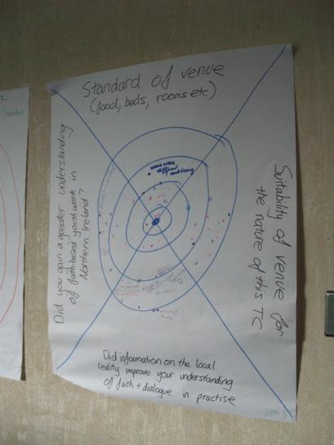

Slide 250

The objectives of this training
The ambition of this presentation is:
to help understand the qualities that a trainer should have and the methods he should use to be successful in his task.
to present the subject and the tools of the training intended for learners “Young ethical leaders”, focusing on team building, and business plan strategies.
to help create a personalized educational kit for teachers on these specific subjects.

Slide 251
Presentation of the "Young Ethical Leaders" project
The main objective of the "Young Ethical Leaders" project is to encourage young people to work independently and create their own jobs through learning, the acquisition of brand personalization techniques, ethical leadership, etc.
https://youngethicalleaders.org/

Slide 252

Presentation of the Guide for Young Ethical Leaders
A guide combining ethics and the latest management knowledge.
A guide written by recognized specialists.
https://youngethicalleaders.org/outputs-become-a-young-ethical-leader-through-self-employment.html

Slide 253

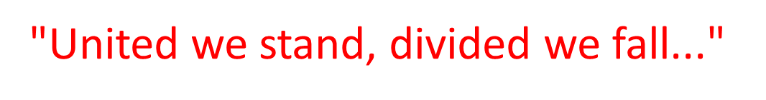
Team
Group of two or more interdependent individuals who interact with one another to achieve a common goal

Slide 254
Why do we join groups ?
- to satisfy interest and goals
- to share and learn
- to build relationship
- to get protection
- to enhance knowledge and skills
- to get better output
- to interact different personalities
- to make effective decision

Slide 255
Importance of teamwork
Together people can accomplish more than individuals can do on their own.
Can learn from each other.
Improves relations among the employees.
Healthy competition among the team members.
Output at a faster pace.
Creates synergy (high motivation, performance level).
Higher quality of decision making.

Slide 256
Downsides of a team
In a team, only a few people may contribute (others are silent, indifferent, afraid to contribute)
Shy and introvert members can’t learn
Few members may dominate the group
Arguments and disagreements may arise
Time and resources consuming

Slide 257

Characteristics of successful team
Leadership and members
Common goals
Clear roles and responsibilities
Participation/Creativity
Interdependency
Sharing and listening
Room for openness and trust
Respect and Loyalty
Support and trust

Slide 258
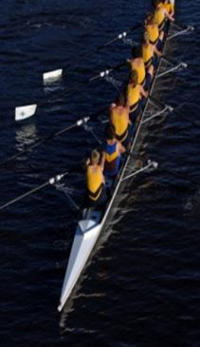
Teamwork
Creating a team is one thing, but creating teamwork is quite another.
Teams don’t work without teamwork.
It’s the glue which keeps a team together, the oil that makes the teamwork.

Slide 259
Teamwork skills
Listening (listen first, speak second)
Questioning (communicating)
Supervising
Respecting
Helping (guidance)
Sharing
Participating/Leading by example

Slide 260
Stages in Team Building (American organizational psychologist Bruce Tuckman in 1965)
Forming
Storming
Norming
Performing
Adjourning

Slide 261
Forming
Stage of initial orientation and interpersonal testing, curiosity
The members of the team get to know one another, seeking and exchanging some personal information and making new friends
Desire to be accepted by others
Gathering impressions about each other

Slide 262
Storming
Stage of conflict over the task and the way of operating
Conflict arises for power, leadership and decision making
competition and strained relationships among team members (emotional and tensed)
This is the most critical stage for the team

Slide 263
Norming
At this stage, come to a mutual plan for the team
Set norms, rules
Agree with others to make the team function
Roles are defined
Rules, values, behavior, method and procedures are established

Slide 264
Performing
By this time, members are motivated and knowledgeable
Competent, autonomous and able to handle the decision-making process without supervision
Participative
Strong commitment
Achievement oriented

Slide 265
Adjourning (Deforming or Mourning)
Task complete
Revision, analysis and evaluation of achievements
Acknowledgment/ Self realization
Strategies
Disassembled

Slide 266
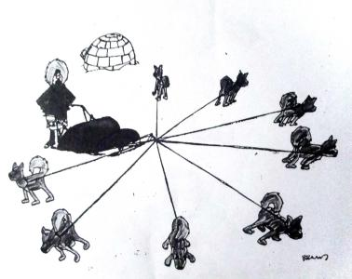
A boat does not go forward if each one is rowing their own way.
So the target must be in same direction
Group purpose must be the same

Slide 267
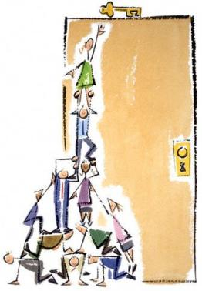

Strong Leadership - always at the top
The more able the leader, the more effective the team.
must have good vision, more knowledge, skill and tactics
takes little more share of blame and less of credit
is a facilitator, not only an order giver
a good listener/ motivator
does ordinary thing extra ordinarily

Slide 268

Building Trust and Empathy
Trust Brings respect and good interpersonal relation.
Creates an easy and learning environment
Plan your project, your idea
Well prepare is half done.
Failing to plan = planning to fail
Plan your work, work to plan

Slide 269

Effective communication is a vital part of any team
Prompt communication can clear things in time
Communicate without hurting anyone's emotions
It is a medium to tie the members in a harmony

Slide 270

Always put yourself in other's shoes, look the things from their side too- Cooperate
Have empathy
Never say, NO, that's not my job !
The strength of the team is each individual member…
The strength of each member is the team.

Slide 271
Common faith
No one is perfect, know the limitations
When we have problem, don't blame it on others, lets share it whatever it is, credit or blame.
Celebrate and reward team achievements
The greatest enemy in a TEAM is .........ego, so never let ego come into your group
Do respect others, others respect you back
Unity is the strength

Slide 272
Summing up
Basic elements of effective teamwork
  Strong leadership
  Clear Roles and responsibilities
  Effective communication
  Collaboration
  Participative decision-making
  Commitment and accountability
  Learning and sharing
  Supervision and monitoring
  Flexibility

Slide 273

Business plan
Every business starts with an idea. But when you have this idea you must structure and organize it to improve your chances of success. You must think about its advantages and problems, about your finances, about your customers and much more. Because of that you should write a business plan which explains everybody your future company. This work will maybe also show you the dangers and difficulties in your idea and help to eliminate them.

Slide 274
Which properties do you need to run a successful
business or to be a successful entrepreneur?
- Eagerness for independence
- Innovative spirit
- Healthy risk appetite
- One´s own initiative
- Impulsiveness
- Achievement- orientation
- Social authority
- Emotional stability
Pro + | Contra -
To be a free agent | Often a lot of work
You meet new people | You must be confident also in hard times
To socialize | Sometimes it´s hard to calm down or keep calm
It´s diversified

Slide 275
Business Idea
Describe your business idea.
Describe the different types of product/ service you are going to be selling (e.g. color, sizes).
Find a business name and explain your decision.

Slide 276
Customer Group/ Target Market
Describe your typical customer (how old, how much they earn, where is he living…).
How many customers are you waiting to buy from you?

Slide 277
Customer Relations
Explain your communication policy (How do you want to present your product to the customers – newspaper, internet…).
Find a strapline, a catchy phrase that goes with your business name.
How will your product be delivered to your customer?

Slide 278
Competitor Analysis
Describe your competitors.
Describe your unique selling point (What makes your product different from others? How will you show your customer that your product is the best?)
SWOT analysis
Strengths (positive things about your business) | Weaknesses (things that could mean you struggle to make your business work)
Opportunities (external factors you can take advantage of – e.g. changes in law or market trends) | Threats (external factors that could affect how well your business do)
Key Activities
Activities: Describe your first steps to realize your innovative idea.
Resources: What do you need to realize your idea?
Human Resources: Who do you need to realize your idea (employee)?
Suppliers: Explain who you have chosen and what they will supply.
Back-up plan
Thing about changes that might be necessary considering the SWOT analysis.

Slide 279

THE OBJECTIVES OF THIS TRAINING
The ambition of this presentation is:
  to help understand the qualities that a trainer should have and the methods he should use to be successful in his task.
  to present the subject and the tools of the training intended for learners “Young ethical leaders”.
  to help create a personalized educational kit

Slide 280
PLAN
The skills and qualities of the trainer
The educational training kit
Preparation of the training - A few days before
Preparation for training - 30 minutes before
Start of training
Some animation tips
Presentation of the Cercle Augustin d´Hippone
Presentation of the "Young Ethical Leaders" project
Presentation of the Guide for Young Ethical Leaders
Animation supports
Educational exercises
Satisfaction questionnaire
Assessment from the trainer
Last words

Slide 281
THE SKILLS AND QUALITIES OF THE TRAINER
Master the field of intervention and want to pass it on,
Appropriate the educational kit and implement it,
Use animation techniques,
Communicate and transmit a message,
Use your knowledge of adult education,
Regulate group phenomena,
Knowing how to assess learning,
Knowing how to analyze one's teaching practice.

Slide 282
THE EDUCATIONAL TRAINING KIT
Project presentation sheet« Young ethical leaders (erasmus+)
https://www.cercleaugustindhippone.org/jeunes-leaders-ethiques/
The guide for young ethical leaders (in two versions: FR and EN)
https://www.cercleaugustindhippone.org/guide-du-jeune-entrepreneur-ethique/
List and profile of interns: Young social entrepreneurs
Tools to be produced or sketched during this training:
  Animation materials: PowerPoint presentation summarizing the Guide
  Educational exercises
  Satisfaction questionnaire

Slide 283
PREPARATION OF THE TRAINING - A FEW DAYS BEFORE
  Know your context of intervention
    Know the target audience: number of participants, profile, level of experience, etc.
    Become familiar with the YEL project by consulting the documents on the CAH website
    Reflect on the objectives and purposes of training
  Know the scope of your intervention
    What tools do you have at your disposal?
    Are you going to intervene alone or in co-facilitation?
    What questions you ask yourself, following this tutorial?
  List your material needs for training
    What will you need on site? (Materials, Guide, etc.)
    What materials will you need? (Computer, board, etc.)

Slide 284
PREPARATION FOR TRAINING - 30 MINUTES BEFORE
Preparing the room
  Table layout
    Depending on your animation technique, U, square, circle or team
    Check that everyone can easily read the projected documents
Your personal preparation
  Plan your personal equipment and check the presence of the planned equipment
  Control your stage fright
    Free yourself from material aspects to focus exclusively on the relationship
    Visualize the good progress
    Move around the room before the trainees arrive
    Get in touch with each of the participants as soon as possible: greet them, discuss, joke, etc.
    Take a glass of water and refocus on your breathing

Slide 285
START OF TRAINING
Making a good impression starts with making an engaging and welcoming introduction
Organizing presentations well, of yourself and of the participants, helps to create a good learning atmosphere
Take advantage of the presentation round table to also collect participants' expectations
Clearly present the program and the course of the training, from a slide or write on a board
Recall the rules of the game and the practical organization: schedules, planned breaks, attendance sheet, etc.

Slide 286
SOME ANIMATION TIPS
Secure
➜ specify the progress of the training
➜ respect the program and the announced timing
➜ do regular summaries
➜ assess your achievements regularly
Involve
➜ make them express themselves regularly while being vigilant to the participation of all
➜ put them in a situation to "do", to act,
➜ get in the habit of letting the group answer the questions asked, only intervene as a complement
➜ ask participants to make bridges with their daily life
➜ ask trainees what they are going to implement
Promote
➜ their interventions by allowing everyone to be recognized
➜ the work provided
➜ make connections with their own experiences
➜ listen to and rephrase what the trainees express

Slide 287
PRESENTATION OF THE CERCLE AUGUSTIN D´HIPPONE
Le Cercle Augustin d’Hippone (CAH) is a 1901 law association born from a grouping of young social entrepreneurs and specialists in different fields having in common the concern for the problems of young people and the interest of working for employment, democracy, citizenship, defense of human rights, in the Euro-Mediterranean perimeter and West North Africa in particular.
Rich in several projects within the framework Erasmus+
« Jeunes Leaders Éthiques »
https://www.cercleaugustindhippone.org/jeunes-leaders-ethiques/
« Educating New Generations In building a Non-radicalised Environment »
https://www.cercleaugustindhippone.org/engine-project-presentation/
« Let make tomorrow’s dreams reality »
https://www.cercleaugustindhippone.org/project-let-make-tomorrows-dreams-reality/
« Un pas l’Un vers l’Autre »
https://www.cercleaugustindhippone.org/projet-erasmus-un-pas-lun-vers-lautre/
« School Programme Against Fake News »
https://www.cercleaugustindhippone.org/school-programme-against-fake-news-presentation/
« New horizons for the BLUE world »
https://www.cercleaugustindhippone.org/new-horizons-for-the-blue-world-presentation/

Slide 288

PRESENTATION OF THE "YOUNG ETHICAL LEADERS" PROJECT
The main objective of the "Young Ethical Leaders" project is to encourage young people to work independently and create their own jobs through learning, the acquisition of brand personalization techniques, ethical leadership, etc.
https://www.cercleaugustindhippone.org/jeunes-leaders-ethiques/

Slide 289


PRESENTATION OF THE GUIDE FOR YOUNG ETHICAL LEADERS
A guide combining ethics and the latest management knowledge.
A guide written by recognized specialists.
https://www.cercleaugustindhippone.org/guide-du-jeune-entrepreneur-ethique/

Slide 290
LE GUIDE DES JEUNES LEADERS ÉTHIQUES – TABLE DES MATIÈRES
The main parts of the guide :
I. ETHICS AND LEADERSHIP
II. SOCIAL RESPONSIBILITY
III. PERSONAL BRAND APPLIED
IV. ETHICAL COMMUNICATION
V. BRAND CONSTRUCTION STRATEGY
VI. TECHNIQUES AND METHODS FOR MOTIVATION
CONCLUSIONS
CREATIVITY DEVELOPMENT EXERCISES
BIBLIOGRAPHY
ELECTRONIC REFERENCES

Slide 291
ANIMATION SUPPORTS
Each trainee must have a copy of the guide in paper format or in electronic format for people with a computer.
  https://www.cercleaugustindhippone.org/guide-du-jeune-entrepreneur-ethique/
The trainer should prepare the following tools using the sketches made during this training:
  A PowerPoint presentation summarizing the main concepts of the guide
  Exercices
    Creativity development exercices to take from the guide
    Other comprehension exercises
Satisfaction questionnaire

Slide 292
EXERCICES PÉDAGOGIQUES
Creativity development exercices to take from the guide
How to build an evaluation MCQ?
  Levels of complexity :
    Level 1: memorize / know
    Level 2: transpose / change register
    Level 3: apply
    Level 4: analyze
  The components of the questions: The instruction, The statement, The proposals
  The rating scale
Other exercises to be defined, especially exercises to be done in small groups

Slide 293
SATISFACTION QUESTIONNAIRE
Write a short training evaluation questionnaire including questions on :
  The means implemented: the environment, the premises, the rooms, the training materials, the teaching material.
  Pedagogy: the practical and theoretical content of training, facilitation, etc.
  The trainer.
  Organization (logistics): the duration of the training, …
  The benefit obtained by the trainees: have the educational objectives been reached, has the training met the trainees' expectations, will they reuse elements learned during the training?
Distribute it to learners at the end of the training :
  Take at least 10 minutes before the end of the training to distribute it

Slide 294
ASSESSMENT FROM THE TRAINER
Analysis of satisfaction questionnaires
  Summary of trainee evaluations and suggestions
Your training evaluation
  Are the teaching methods adapted? (Exercises, work in sub-groups, scenarios ...)
  Have the materials in the educational kit been useful?
  Is the duration in line with the objectives?
  Have the educational objectives been met?
  The material conditions were suitable for the animation?
  Possible observations on group dynamics and the profile of participants
  Other comments or suggestions
Report to be submitted to the CAH including the summary of the satisfaction questionnaires, your evaluation and the attendance sheet

Slide 295
LAST WORDS
A good trainer must constantly manage to create a balance between these essential qualities :
  mastery of their subject (s),
  didactic and pedagogical skills,
  the ability to build a relationship with learners.

Slide 296
LAST WORDS
A good trainer must constantly manage to create a balance between these essential qualities :
  mastery of their subject (s),
  didactic and pedagogical skills,
  the ability to build a relationship with learners.

